Slide 1
Capital Quest
Be a history detective at Dumbarton House!
Notes:
A teacher or guardian can facilitate this virtual tour by reading the information in the Notes section on each slide. There are answers after most questions, so do not read these until the child or student has answered.
This program is designed for students in grades 3-5. Older students can facilitate the virtual tour by reading the Notes section themselves.
At the end of the document are the I-Spy images that the students should look for in each room of the house.

Slide 2
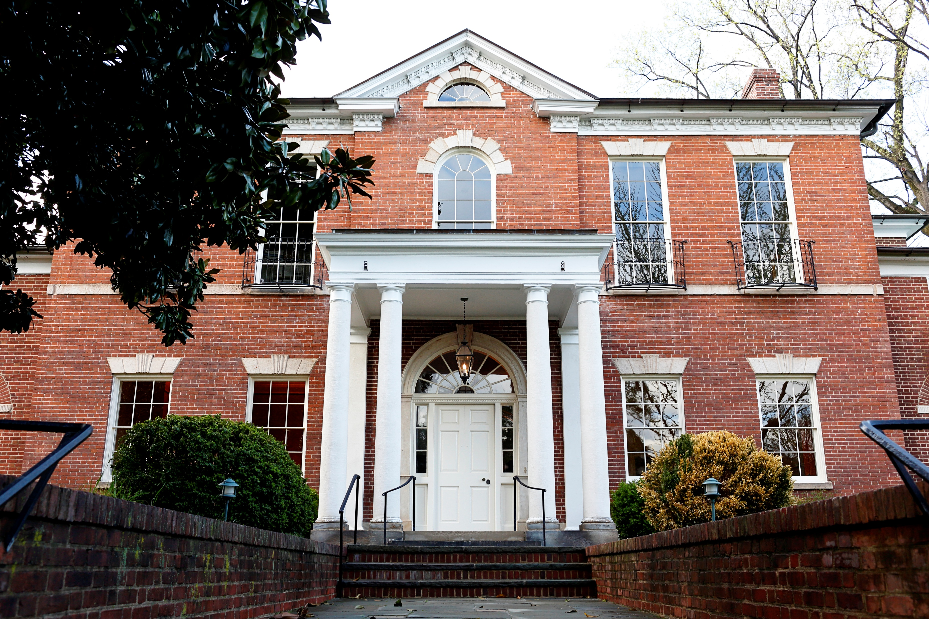
Dumbarton House
Notes:
Today we’re going to be exploring this house, a very old house that is now a museum. It is called “Dumbarton House”
Way back, more than 200 years ago, a man named Joseph Nourse lived here with his wife Maria and about 10 indentured and enslaved workers, including Dinah and Bacchus. Joseph and Maria had two kids who were adults when they lived here named Charles and Josepha. Joseph was the first Register of the Treasury. What does it sound like his job was? Treasure is like money, so he was in charge of all the government’s money. Although many people have lived here over the past two hundred years (and no one lives here now), we’re going to talk about the time when Joseph lived here in 1804.
As history detectives, you are going to virtually tour Dumbarton House looking for artifacts that tell us what life was like in Washington D.C. 200 years ago and why it was chosen as the capital city. Along your tour, you will learn about the members of the Nourse household and their lives.

Slide 3
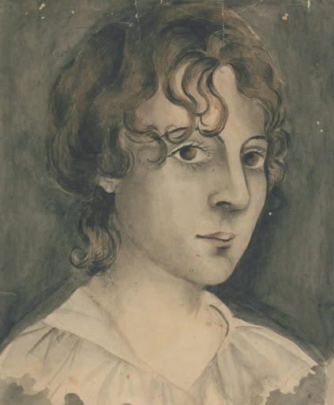
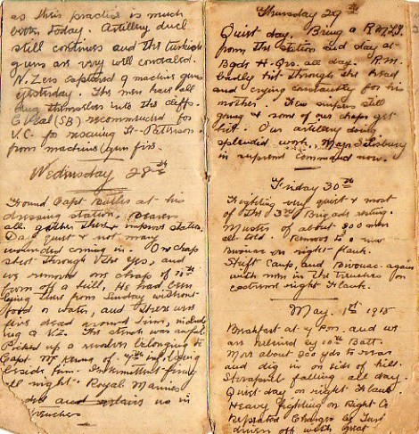
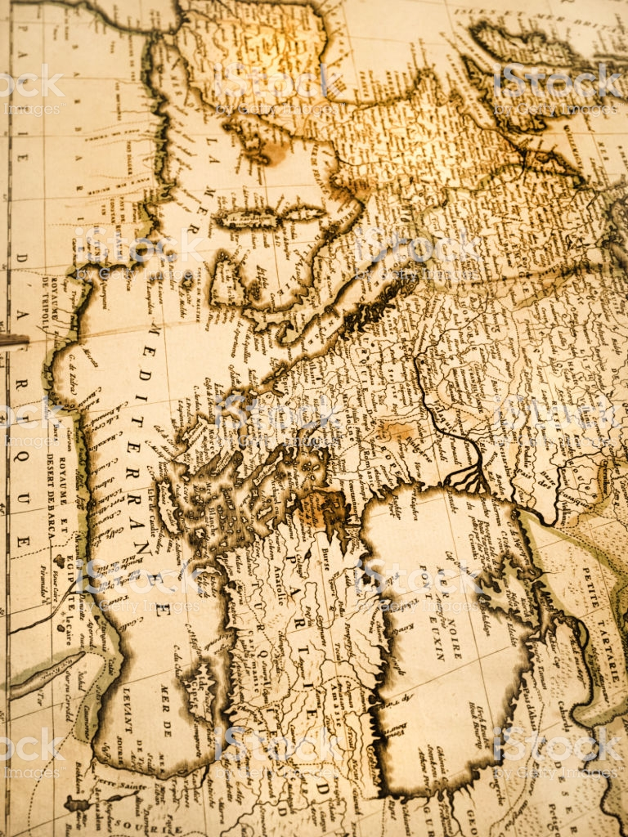
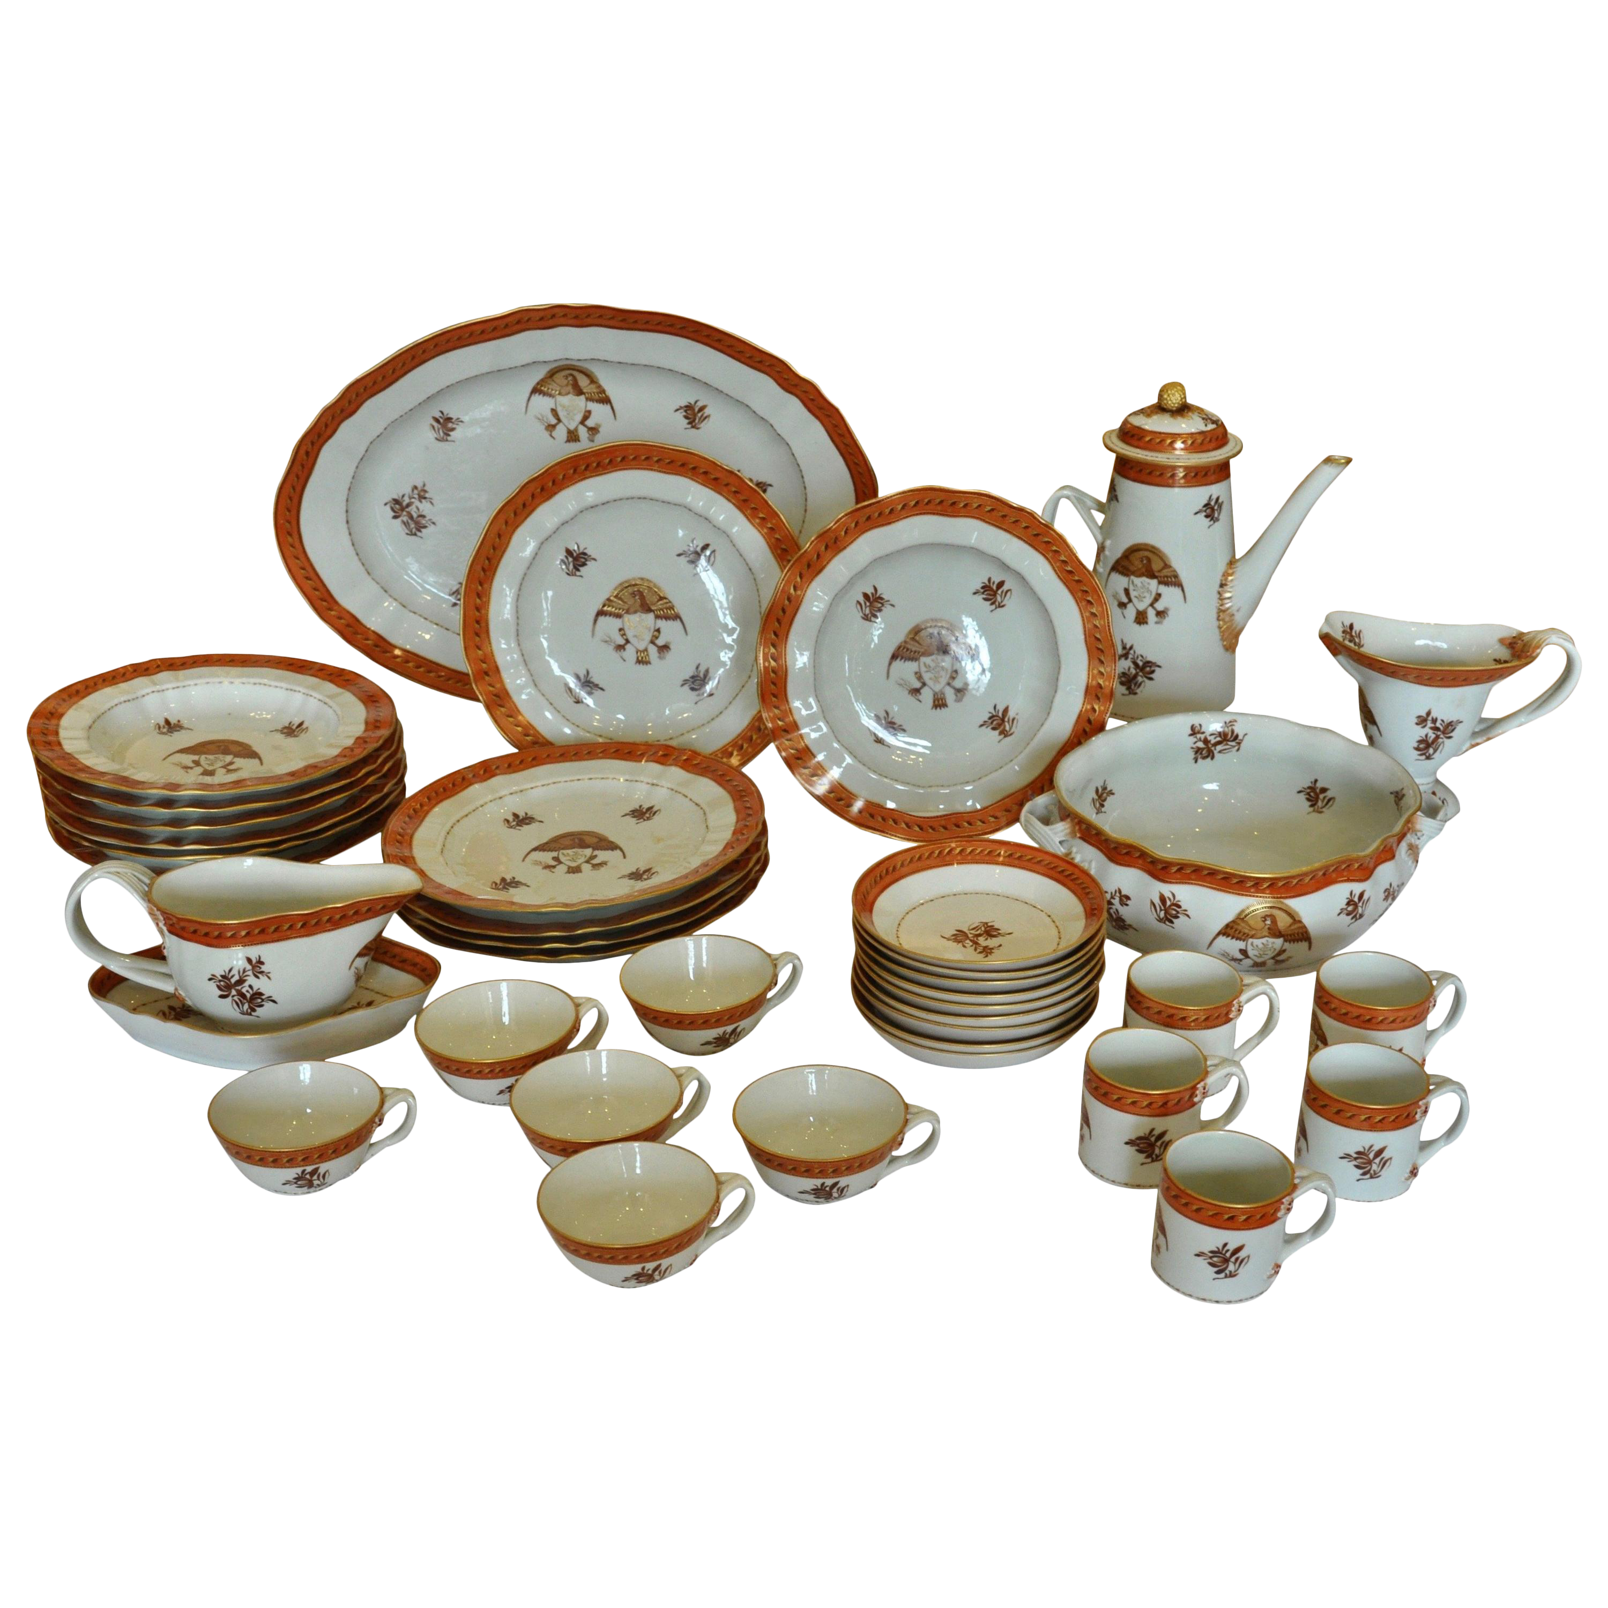
Primary Sources
Notes:
Today, Dumbarton House is a historic house museum that has a collection of objects and documents from the period when the Nourse family lived here. These objects and letters are known as primary sources.
Who can tell me more about primary sources?
▪ A primary source is a document, diary, letter, or other sort of written evidence, or physical objects created or otherwise made during the time period you are learning about. Primary sources offer an inside view of a particular event or time period.
o Can you name some examples of a primary source?
(examples: Map, drawing, diary)
o What are some examples of primary sources a historian could use to learn about your life?
(examples: A photo of you, your homework, your Spotify playlist)
o What can we learn from a primary source?
We can learn how people lived in the past. History detectives use primary sources to learn information and find clues about the past. With your help this morning/afternoon, we are going to be spying for some of these primary source items to learn about what life was like 200 years ago. At the end of this document are objects that you will try to find throughout the house. When you see your object, you can read the primary resource that goes with it! Let’s get started!

Slide 4
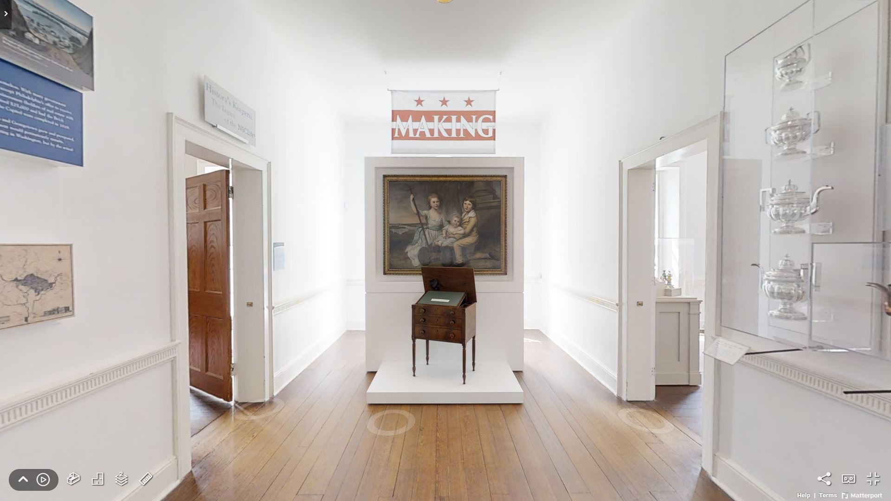
Notes:
This is the “Upper Passage,” or hallway on the second floor of the museum. When the house was first built and lived in, this area was the hallway in between four bedrooms. Now we use it as exhibit space to tell more stories about life in the past. This room is about the making of Washington DC and why it was chosen as the location for the capital of the United States!
Let’s move forwards and take a closer look at the painting of those children…

Slide 5
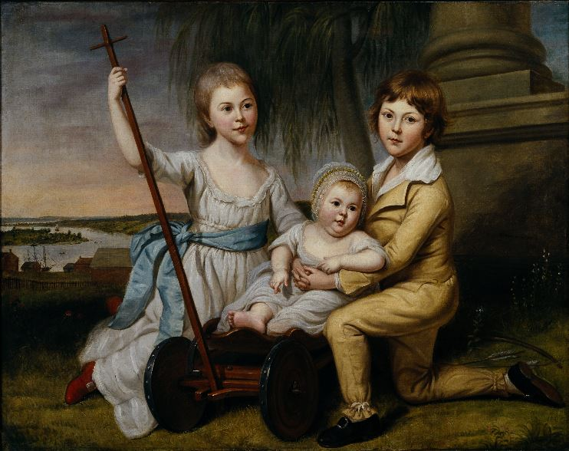
Notes:
Ask: What do you notice about the background of this painting? Does anything surprise you?
● These are the children of Benjamin Stoddert, first Secretary of the Navy. This painting was done at his home on Prospect Street in Georgetown. The background is very important because this is one of the earliest images of Georgetown.
o What do you see in the background?
(Potomac, buildings, ships, tobacco warehouses)
▪ Tobacco was the main cash crop, an agricultural crop which is grown for sale to return a profit, exported in Georgetown.

Slide 6
Notes:
This is a modern photograph of the same scene as the background we saw in the previous painting.
Asks:
o What are some things that are the same in Georgetown today?
(Potomac River, some buildings, still have roads, etc.)
o What are something things that are different?
(We have more buildings now, no ships, paved roads, etc.)
Transition: Now I want everyone to put on your spy goggles! Let’s investigate a map of downtown Washington, D.C. from the same time to see what else we can learn about the city in 1800.

Slide 7
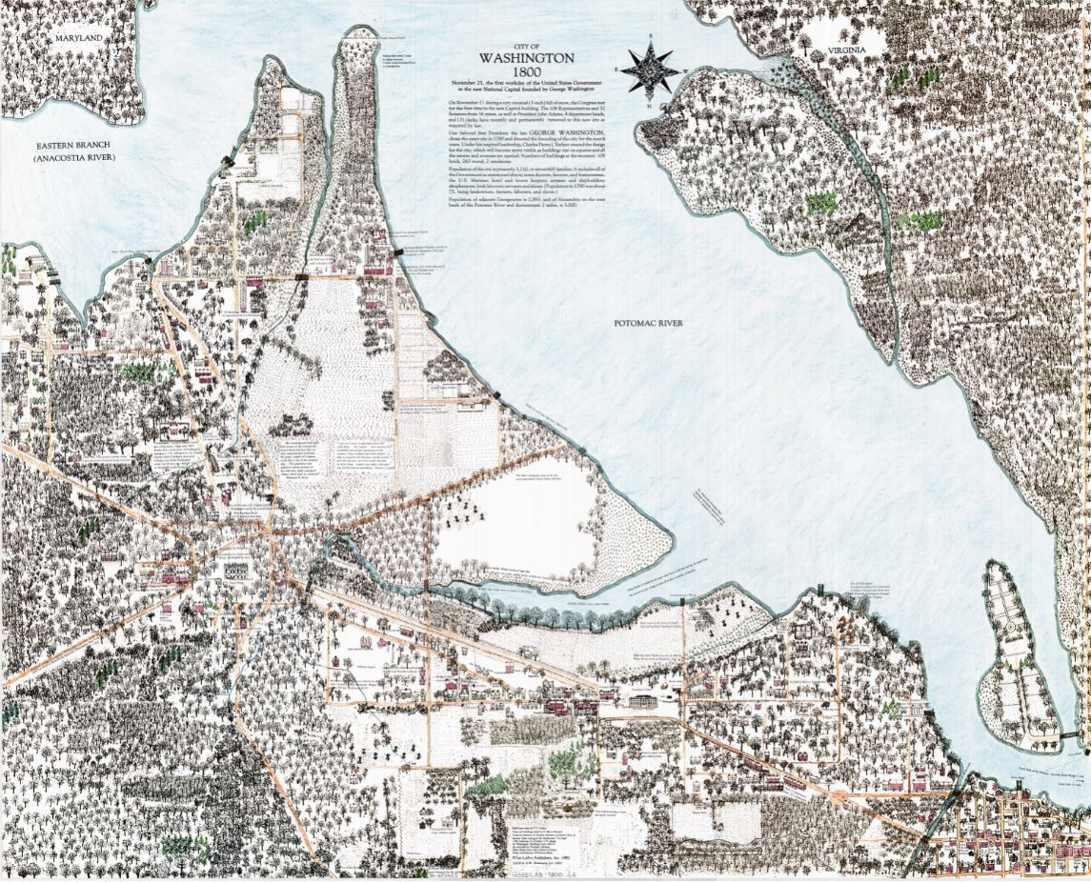
Dumbarton House
White House
The Capitol
Potomac River
Washington DC
1800
Anacostia River
Notes:
This is a map of Washington DC from 1800
Maps are considered primary sources. Remember, a primary resource is something that was made in the time period we are studying and it is used to learn more about what life was like in that time period. Today, we are going to use this map to learn about what Washington D.C. looked like when the Nourse family lived here.
● Asks:
o What are these brown lines on the map? (Streets)
Are there a lot on this map? Why are they brown instead of black like today’s streets? (because they’re made of dirt, not paved)
o What are these black and green circular marks? (Trees) Are there as many today?
o What are these black squares and rectangles? (Houses) Are there as many as today?
● What’s the same as today?
o Identify rivers that still border D.C. (Potomac and Anacostia)
o Identify buildings that still exist in D.C. (Capitol, White House, Dumbarton House)
o Identify that there are more streets, buildings, etc. and less trees, open space, etc.
Now that you know what Washington, D.C. looked like over 200 years ago, why do you think Washington, D.C. was a good place to locate our capital city?
● Lots of natural resources. What is a natural resource?
o A natural resource is a material that comes from the Earth and in its raw or “natural” state is valuable for one reason or another. A natural resource is not man made, but created by nature. Natural resources include oil, timber, and water, minerals, metals and ores like salt, coal, gold, iron, aluminum.
o What natural resources were available in Washington, D.C. 200 years ago?
▪ Rivers/Water: Why would it be important to have water nearby? Ships were the main method of transportation 200 years ago, water is used for drinking, farming, etc.
▪ Land/space for building
▪ Trees for building material, fire wood (cooking/warmth), etc.
● Interesting fact: DC had a huge deforestation problem because they cut down all the trees for manufacturing.
o Are those resources still available today? Do we still use the rivers to transport goods? Is there still lots of room to build on or trees to supply building material?
▪ Today, people build UP to accommodate more people.
▪ Today, parks/The National Mall help us maintain nature and outdoor spaces.
● Washington, DC had a temperate climate.
● Washington, D.C. was a central location for the original 13 states. Is it in the North or the South? It’s kind of in between!
Transition: Now that you are starting to make important connections between Washington, D.C. in 1800 versus today, let’s explore the rest of the house and meet some members of the Nourse Household.

Slide 8
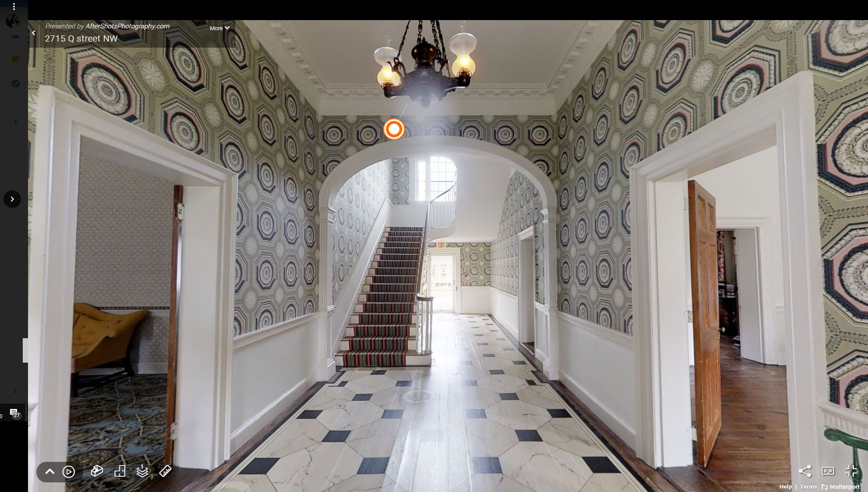
Notes:
This is the Lower Passage, the entry point into Dumbarton House. If you stepped through the front door, this is what you would see. The decorations in this space reflect the effort used to create an impressive room for visitors coming to the house.
Big Ask: Let’s think about what was outside this door and what the visitors may have seen on their way to Dumbarton House in 1804, over 200 years ago.
o What would it have been like to travel on dirt roads in a carriage, on horseback, or on foot?
(Loud, dirty, smelly, difficult)
o How does that compare to what you saw today on your way to Dumbarton House?
Transportation would not have been easy in early Washington. The roads were made of dirt and visitors would have traveled in a carriage, on horseback, or on foot. Visitors to Dumbarton House would have included Charles Nourse, the son of Joseph and Maria, and his wife, Rebecca Morris Nourse. Charles and Rebecca lived in Washington, D.C., along with their 11 children, in a home known as The Highlands (which still stands on Wisconsin Ave today!).
Do you see one of your I-Spy images? When you find one, go to the next slide!

Slide 9
Notes:
Argand Lamp (Invented by Swiss Physicist Aimé Argand, c. 1820)
QUOTE: “[The House sits] on a high, dry, & handsome situation, & consists of a large two story brick house with a passage through the center, four rooms on a floor, & good cellars” (Description of Dumbarton House at auction)
This quote does not tell us about the Argand Lamp, specifically, but it references the entryway we are standing in right now. Thanks to this primary source, we know what Dumbarton House was like when the Nourse family purchased it. As you can see, this is the “passage through the center.” From here, we can see three doorways, which are three of the four rooms mentioned as being on the first floor – the fourth is hidden by the staircase (and there are four more on the second floor!).
Asks:
o What do we use to provide light when we are inside?
o What would Washingtonians have done 200 years ago?
(They didn’t have electricity, so they had to use candles, oil lamps, firelight from fireplaces, or natural light from windows)
o How would a lack of electricity have impacted your life?
(Earlier dinner time, bedtime, candle light attracting bugs in summer, etc.)
o Why would an Argand lamp be an important innovation? It’s like the iPhone of lamps, the best and brand new technology of the time. It used oil to burn much more brightly than a candle would shine.
200 years ago, Washingtonians did not have electricity. They used candles and oil lamps, like this Argand Lamp. The Argand Lamp was an important innovation because oil took less time to prepare and maintain than candles, burned longer than candles, and provided better quality lighting.
Floor Cloth (Reproduction c. 1998)
QUOTE: “Geneva, New York, August 15 1813: My dear Mother, Tell me when you go to… Northumberland—I should then be able to hear from you… in two or three days as it is on the express route… Adieu to you & my [dear] father… [Charles Nourse]”
o What are they referring to by “express route”?
(It’s the mail route system. How do you communicate with your family when they are far away from you? Phone, video chat, text. 200 years ago, they didn’t have any of that, so they had to write letters. It was considered fast to be able to hear a reply in 2-3 days. Does that sound fast to you?)
o Think about what the roads were like around the country and the new roads in the capital. Where might “express routes” be located? (In the City) Why? (More people)
Asks:
o What are roads in DC made of today? (Asphalt) In the Federal Period? (Dirt)
o Why would a floor cloth be useful?
o Why might they have a floor cloth in the entry way and not carpet like in other rooms?
The floor cloth was useful because it protected the wood floors from mud tracked in by visitors to Dumbarton House. The floor cloth was made by painting canvas and covering it with a varnish so it could be removed and easily washed, which was easier than cleaning the wood floors. This one is painted to look like marble, so it makes the room more fancy looking.
Transition: Once Charles and Rebecca had arrived at Dumbarton House they might have been ushered into the Parlor Room where they would enjoy entertainment. Let’s enter the Parlor and meet Josepha Nourse.

Slide 10
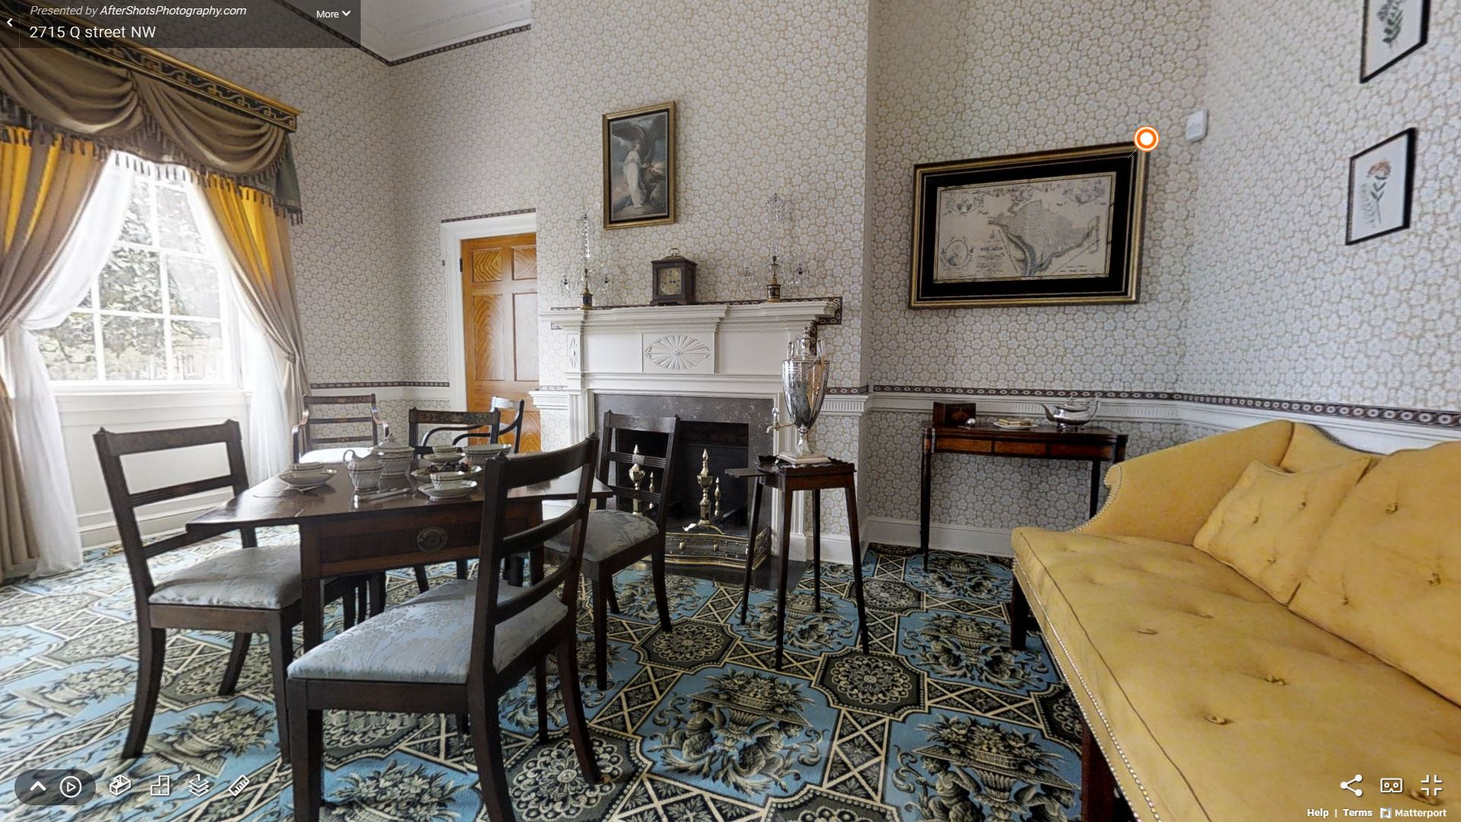
Notes:
This is the parlor, which is like a fancy living room. It was used by Joseph and Maria Nourse to entertain their friends with a variety of activities, but for now, we will focus on Josepha (Sepha) Nourse and the education of young women in the Federal Period. Women’s education focused on fine arts, including needlework and music.
Big Ask: Now that you have gotten a peek into what education was like for girls in the Federal Period, in what ways are these activities different and/or the same to what you learn in school today?
Do you see one of your I-Spy images? When you find one, go to the next slide!

Slide 11
Notes:
Lemoine Sampler (by Maria Magdalene Lemoine, c.1800)
QUOTE: “[Philadelphia] April 25th, 1803: My dear Josepha, All my sisters go to Mrs. Jaudon’s school they review all the lessons they say through the week over on Friday & if they say them perfect… they obtain… books… Jane Miller”
In this quote, we learn that Jane has a test every single week, on Friday. If a student answered everything correctly, they got books as a prize! How is that the same or different at your school?
Asks:
o What types of projects do you do in art class today?
o How do you think this image on the wall was created?
This is needlework, a type of sewing, and it was made by 12-year-old Mary Magdalene Lemoine. We call it a sampler because it was a way for young children to practice their sewing skills. Needlework was important for a young woman’s education in the Federal Period. It was common for young children to learn how to sew because it was a necessary skill and was believed to strengthen their fingers and better prepare them to write.
Asks:
o Who do we see in the sampler? (It’s hard to see, but in the corner is George Washington)
o Why might he be included in the sampler? (Important national figure)
o What is the larger image in the sampler? (Map of the City of Washington)
o Why would a map of Washington be included? (It was the new capital of America)
There are other American symbols, like personifications of Justice, Liberty, Hope at the top. A personification is a person representing some larger concept.
This room not only helps us understand Josepha and education during this time but also highlights how people in the Federal Period wanted to view their newly formed country. Art was a way of trying to define the new Republic and understanding America’s place within the world. Though women in the Federal Period did not have the rights that we do today, they expressed patriotism through their artwork.
Transition: Another popular pastime in the Federal Period was “taking tea”.
Tea Box – “George III Inlaid Fruitwood Tea Caddy” (ARTIST, c. 1790)
QUOTE: “May of 1805: Mr. Foster called one evening, drank tea and [imparted] Ms. Merry’s regards… Joseph Nourse”
Asks:
o What is on the front of the box? Right above the shell image? (A lock)
o Why would there be a lock on the front of the tea caddy?
(Where did tea come from? China and India. How did it get to the United States? No airplanes, so it came on big wooden ships. It was expensive because it had to be shipped across the ocean. It was packaged in “bricks” or “blocks” of tea, which is lots of tea leaves pressed together. Pieces would be broken off and dropped in hot water to make tea, so a tea strainer was needed to make sure you didn’t drink bits of leaves. Now, most people use tea bags)
o Do we still drink tea today? (Yes, but it’s not as hard to get as it was 200 years ago)
o What types of drinks do you like?
In the Parlor after dinner, guests would often share tea and conversation. This is what we call a tea caddy, used to store tea blocks that would then be added to the hot water urn (point to) and prepared to enjoy. Tea was very expensive, as it was grown and produced in China and India, and then would have to be shipped to America. The Nourses would have kept the tea carefully locked up.

Slide 12
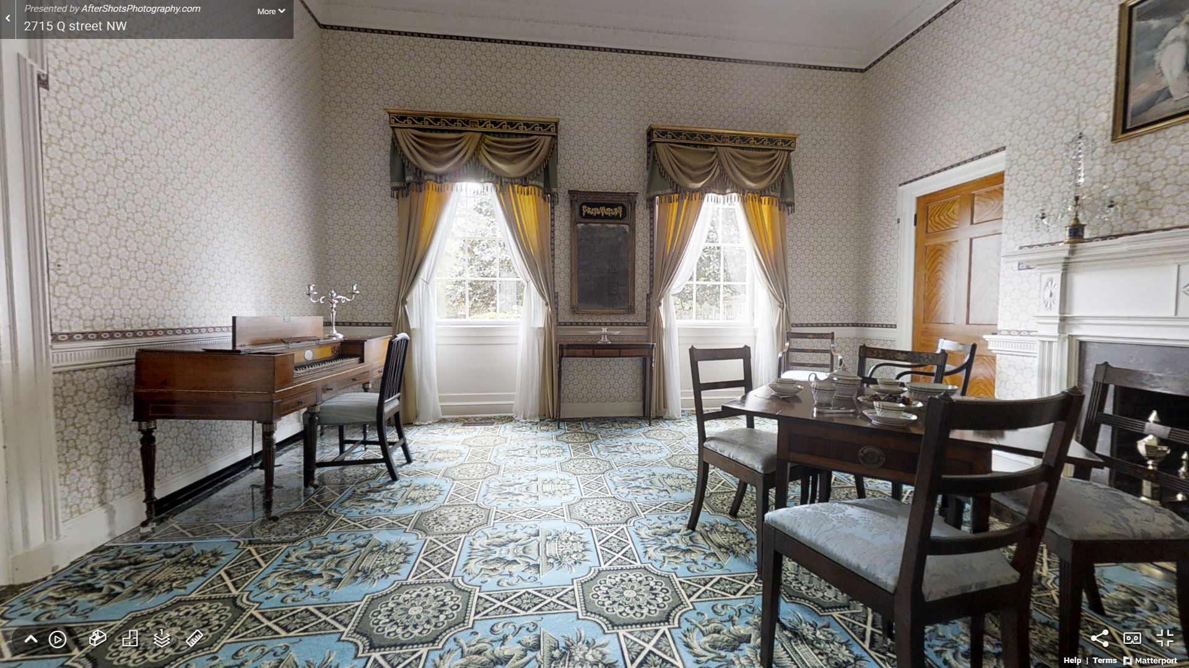
Notes:
Here is another view of the parlor. Does anyone see another I-Spy?

Slide 13
Notes:
Piano Forte (by George Astor and Co. in London, c. 1805)
QUOTE: “Wednesday morning 13 Sep. 1796: My dear Love, I mean to get a Forte Piano for Sepha when she has learned to play well on the Spinet… Mia I am yours – J. Nourse”
In this letter, Joseph is writing a letter to his wife, Maria, who he calls by the nickname “Mia.” He says he wants to buy his daughter Josepha, whose nickname is “Sepha,” a piano forte, which is the type of instrument you see here, an old piano. A spinet is a similar instrument but works a little differently. In a piano, when a key is pressed, a hammer hits a string to play the note. In a spinet, when a key is pressed, a string is plucked, so it sounds different than a piano.
Asks:
o Do we play instruments today? What instrument do you play?
200 years ago, in the 1800s, it was most common for boys to play instruments like the flute or violin, while girls commonly played the piano forte, guitar, or harp. Why do you think that was? How do you play a violin? (Mimic it with your arms). How do you play the piano? It was considered “unfeminine” for women to raise their elbows and move their bodies, as required for violins and flute.
o How is our method of hearing music different today than it was 200 years ago?
(Today we can listen to music on our phones, computers, radio, and on apps. 200 years ago, the only way to listen to music was live! They had no radio, no CD players, no records – which are like really big CDs) Music was very popular during the Federal Period so it was important that people learn how to play instruments or sing.
Transition: In the next room, we will meet Joseph Nourse and learn more about how the family’s tea made it to America from far away.

Slide 14
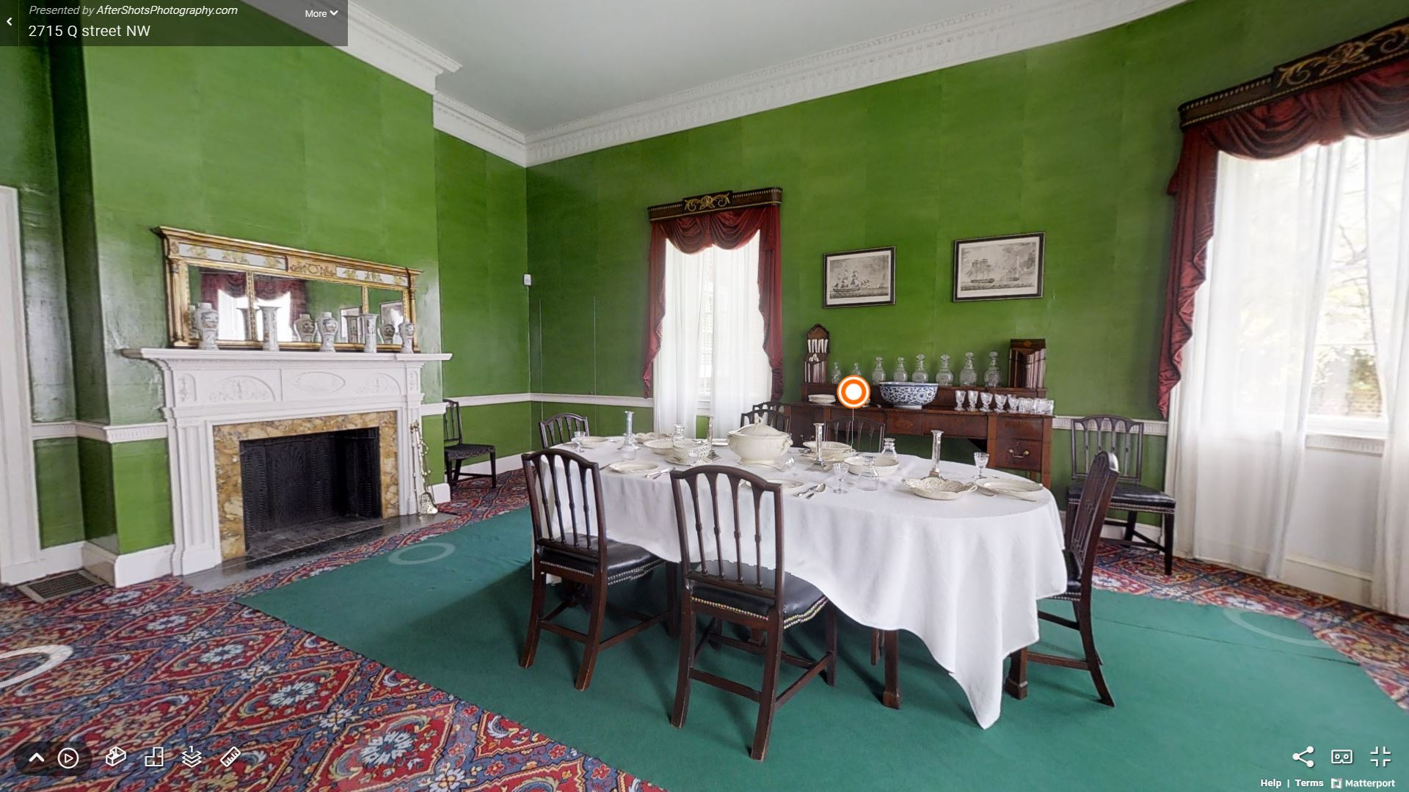
Notes:
The dining room was used for formal dinners and entertainment of guests/visitors to Dumbarton House. Many of these guests would have been political figures that worked with Joseph Nourse. Because he was the First Registrar of the Treasury, he would have had important dinner guests to entertain. During this time, it was unusual to have a special room reserved just for dinner parties. Similarly, today not everyone has a dining room. Where do you eat your meals?
Many dinner parties during this time would be spent by discussing the newly formed government and capital city. The Republic was still new and so people debated how the government should work.
What image do you see in the prints on the wall? (Ships)
o Why might ships be displayed throughout this room?
(Because Georgetown had an important port, where they exported tobacco)
o What do the images of ships around the room suggest about the way Americans viewed themselves at this time?
(Americans were proud of their industry and the goods they grew and made to sell)
Do you see one of your I-Spy images? When you find one, go to the next slide!

Slide 15
Notes:
Creamware – “Hogs Head of Queen’s Ware” (Campbell & Kingston, c. 1783)
Philadelphia 14th November 1783: 1 [large] Tureen & Ladle. 12 [dozen] plates, 1 [dozen] Mustard Spoons, 4 large Oval Dishes, 10 baking Dishes”
This is a list of objects that Joseph Nourse used as a receipt. Receipts are also primary resources.
Asks:
o Do you recognize the items on the table? Does this look like your dinner table?
o How do you or your family members pay for what you buy?
o Why might Joseph Nourse have kept a record of what he bought?
(He had to use cash, not credit cards, so he did not automatically have receipts, like we do on our computers and phones. He had to keep track of every object and how much it cost in an “account book” so he could budget his money)
The dining table and dining materials on the Nourses table belonged to the Nourse family. It is referred to “Creamware” because of its cream color. The table is set for the 1st course of a meal. You can see serving dishes in the middle surrounded by individual place settings. There were traditionally 2 courses and a dessert at formal dinners.
While we still have windows in our homes today, they don’t seem very special. They were very important in the Federal Period. We know that there was no electricity 200 years ago. Because of this, daylight was very important. When do you eat dinner? The Nourses would have had the biggest meal of the day at 2 or 3 o’clock in the afternoon when it was still light outside! If they were still hungry at night, they would have a smaller meal or snack. The curved walls and large windows in this room allow the highest amount of sunlight to come into the dining room, allowing Joseph Nourse and his guests to see what they were eating and see who they were talking to.
What are other sources of light in this room?
Candles and the fireplace. But candles melt and fire burns up – both need to be purchased again. Sunlight is a free natural resource! Also, fire is dangerous and can burn down your wooden house, so if you have other options, you would use those.

Slide 16
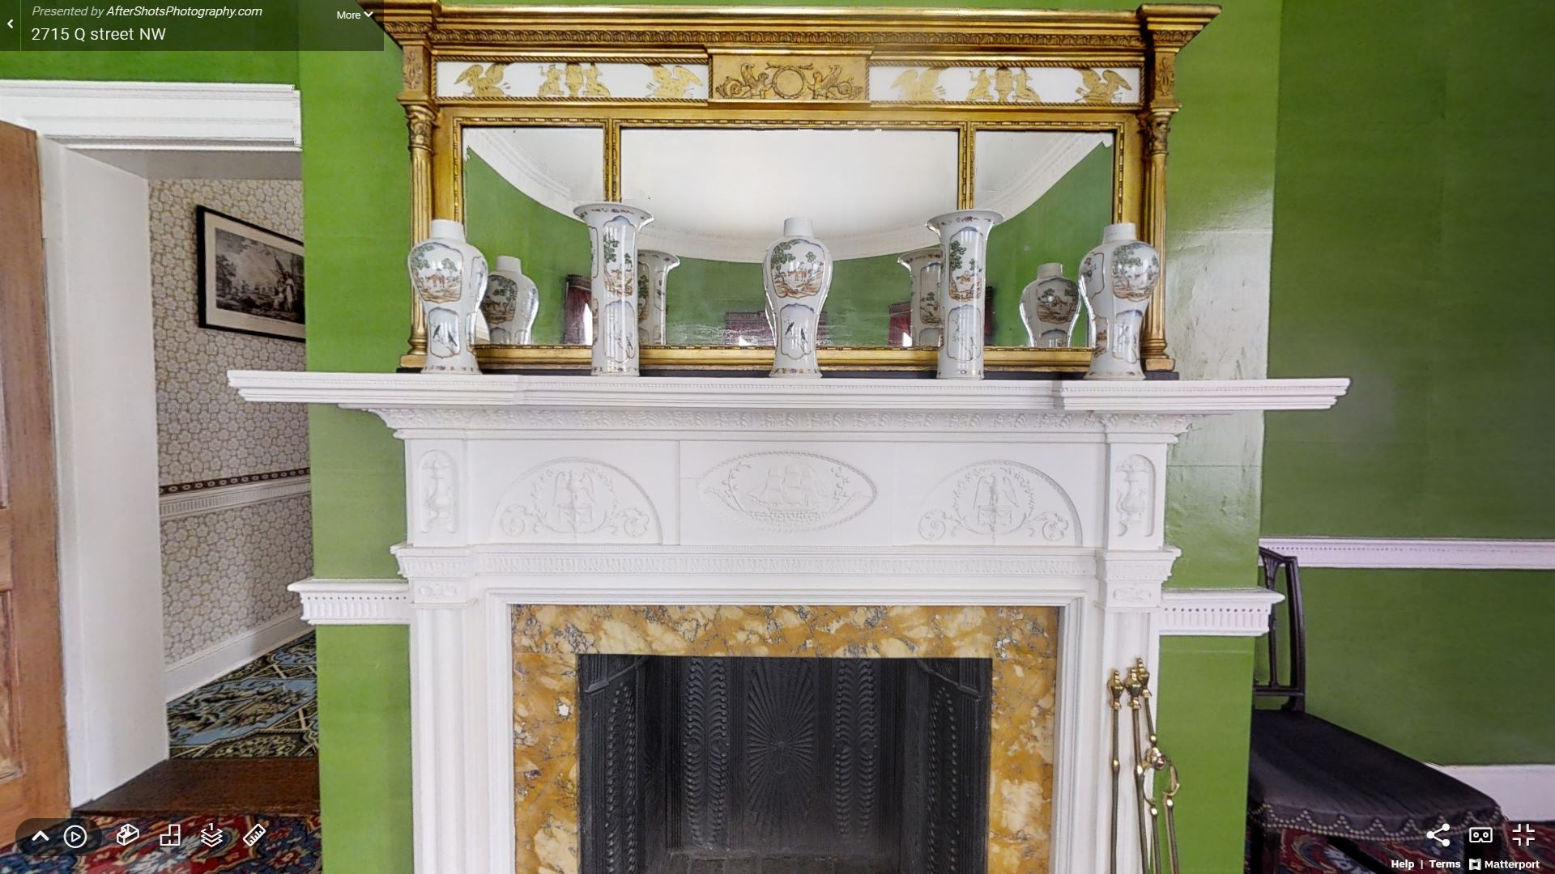
Notes:
Does anyone else see their I-Spy in this view of the dining room?

Slide 17
Notes:
USS Constitution Ship Mantel (c. 1815)
QUOTE: “Washington City, [April] 8th 1808: Dear Charles, We have samples of excellent wool sent [to] us from different… States… not unworthy of the best manufactories in England. Accept my wishes for your happiness… John Smith”
In this letter, John Smith is bragging about the quality of wool that is produced in the United States. He is saying that it is just as good as the best wool in England. He is showing his patriotism for America and her products.
Asks:
o How would early Washingtonians have traveled in and out of D.C. 200 years ago?
o How do you travel to see family or friends who live far away?
Would early Washingtonians have had that option? (No)
o How do we get resources into the city today? (Trucks, planes, trains)
How would resources have gotten to the city 200 yrs ago? (Horse, carriage, ships)
o What are the two main rivers that surround D.C.? (Potomac and Anacostia)
Do we still travel on boats on either river?
Ships were the fastest way to travel 200 years ago, as there were no trucks, planes, or trains to travel long distances. The Potomac and Anacostia rivers would carry people and supplies (tea, coffee, furniture, china, etc.) into Georgetown from far away. Even though the Potomac isn’t a big shipping river today, people still ride boats and take ferries as a different mode of transportation or for fun.
The Potomac is shallower today, partly because tobacco and other crops encouraged runoff and the river silted up. Big ships can’t come up as far as they could 200 years ago.
Transition: Now that you have seen the rooms where the Nourses would have entertained their guests, let’s take a look at a room I think you will recognize. There we will learn about Maria Nourse.

Slide 18
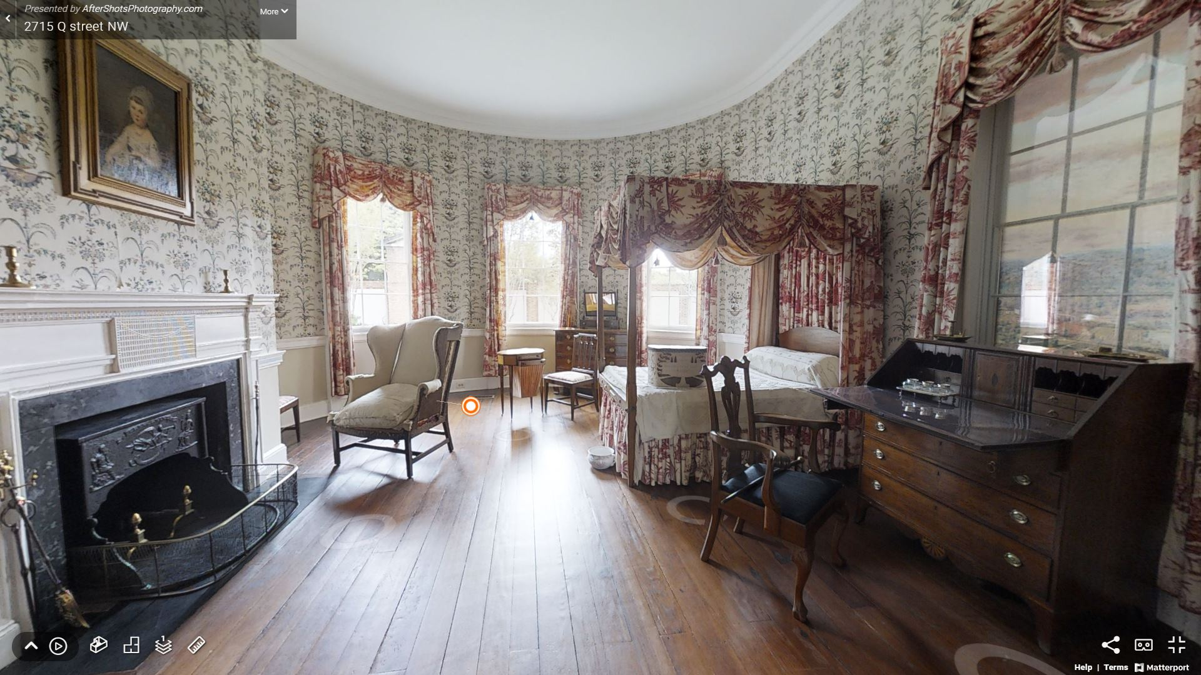
Notes:
This is the best chamber in the house and was used as the bedroom of Joseph and Maria Nourse. We might call it the “master bedroom.” Bedrooms served multiple functions during the Federal period. Maria Nourse would have kept the house records here at a desk like this one, and would have given enslaved workers daily tasks, wrote letters, and stored herbs and jam in this room. The kitchen was right around the corner. Because she worked nearby, she would have been able to oversee domestic activities of the enslaved and indentured workers as they performed daily tasks.
Do you see one of your I-Spy images? When you find one, go to the next slide!

Slide 19
Notes:
Work Table (c. 1800)
QUOTE: “June 3rd 1805: My dear mother, I purchased ten yards of… linen… which Jane has amused herself with making a covering for [Dinah]… and making Fran an apron. From your ever affectionate [Charles Nourse]”
Asks:
o What do you think Maria might have used this object for? How does the primary source give us a hint?
(It’s about sewing, so this was a sewing table!)
This table was used to hold yarn, thread, and small amounts of fabric for easy access. The majority of clothing and household items were made at home by the family or enslaved workers. Women, including the lady of the house, would have done some of her household duties from her bedroom including sewing. The pink basket that hangs would have held her needlework supplies and Maria would have used the top of the table for her needlework. There are tiny wheels on each leg, so the table could be moved to find the best natural light coming through the windows. Sewing tiny stitches requires good eyesight and bright light!
Transition: Now that you know that clothing was made by the lady of the house and enslaved workers, where do you think those textiles might have been held? Let’s go to our next I-Spy to find out more.
American Wallpaper-Covered Bandbox (c. 1815)
QUOTE: “Monday Morn July 15th 1796: My Dear Friend… Take my Spring Muslin habit and peticoat with the cuffs… You will please to roll them as small as possible and pin a strong pocket handkerchief round them… Farewell my dearest Friend says your own, Maria”
Asks:
o Do you see any closets in this house? Where would people keep their clothes?
o Where would you keep your small accessory clothing items?
Closets were not popular in the Federal period, so people used linen presses instead. Because individuals only owned 5-6 outfits each, a linen press would hold all the clothes and linens for the entire family! Because cloth was so expensive and people had only a few outfits, they would make their outfits look different with accessories like sashes, necklaces, and detachable cuffs. The Nourses would have kept these smaller items, like combs, sashes, belts, ties, or cuffs, in a bandbox like the one you see on the bed. They would be wrapped in wallpaper scraps or handkerchiefs like the one in the quote. This bandbox includes a picture of the New York City Hall.
o Why was New York City important in the Federal Period? It was where the capital was first located. It moved to Philadelphia and finally to D.C.
There is another American symbol, our national bird the Bald Eagle, decorating the side of the bandbox.
We’ll discuss the view from the window in the next few slides.

Slide 20
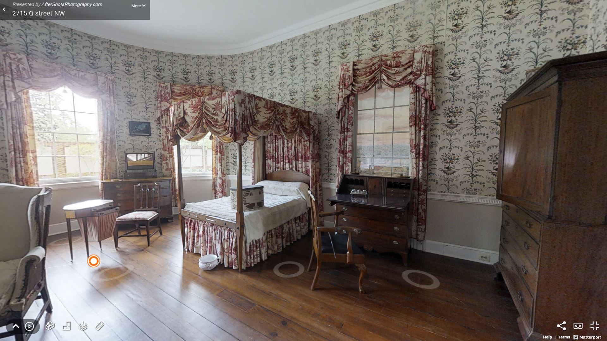
Notes:
Transition: Maria Nourse managed the domestic household here at Dumbarton House. Let’s go into the next room to learn about some of the enslaved persons that worked at Dumbarton.
We’ll have a closer look at the view in the window in the next slide! An artist painted it as a recreation of what the view would have been out of that window 200 years ago…

Slide 21
Notes:
Farm Painting (by Peter Waddell, c. 2017)
QUOTE: “Thursday 2nd August 1804: Richard came down yesterday with a bag of apples which Dinah is pairing for dinner… [Sunday] evening 5 August 1804: Dinah has supplied the table with fried bacon, an apple dumpling and a rice pudding… Distribute my love to all, [Joseph Nourse]”
What kinds of things was Joseph eating for dinner? Apples, bacon, and rice. Does that sound similar or different to what you eat for dinner?
Asks:
o Where does your food come from today?
o Where do you think food came from 200 years ago?
o What types of food would the Nourses and their enslaved workers have eaten?
From letters that the Nourses wrote, we know that Dinah was an enslaved woman who served as the family cook for over 25 years. She lived on Dumbarton property and had a child here. Today, we go to the grocery store or the farmer’s market to buy our food. To supply the table 200 years ago, Dinah would have used vegetables and herbs from the kitchen garden. She also might have visited a local market near the waterfront in Georgetown (where Dean & Deluca is today). The Nourse family would have grown most of the food they would have eaten, like other families in Washington DC. They also had pigs, chickens, and cows on their farm here in Georgetown. Can you see some of those animals in the farm painting?
Transition: Now let’s focus on how that food was presented to the Nourse family inside the house.

Slide 22
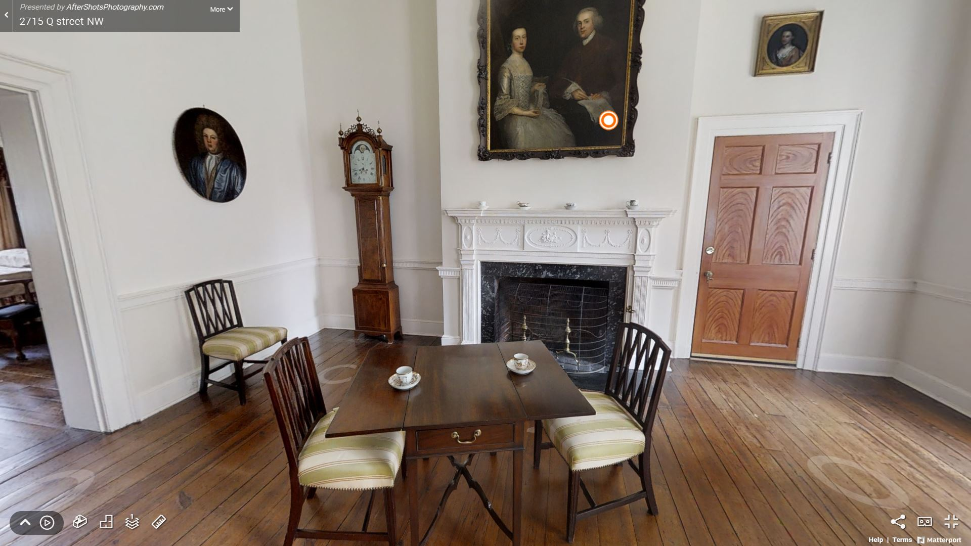
Notes:
This is the breakfast room where the family would have enjoyed meals, tea, and spent time together (like today’s ‘family room’ or ‘den’). This room was also once connected to the kitchen by a covered way through the doorway you see to the right. Few people in the Nourse household likely knew the passage better than Frank, who served the family meals.
Asks:
o What types of things might you have seen outside Dumbarton House?
o What would it have smelled like outside? Sounded like? Think about what you saw in the painting on the last slide.
o How is it similar or different from farms you see today? (No farm equipment like tractors)
In 1805, Dumbarton House was surrounded by 8.5 acres of land. Though we do not know the exact view, we can imagine seeing farmland around the house, including outbuildings, crops, animals, or workers. There was a kitchen, barn, smokehouse, and 3 cabins for the enslaved and indentured workers. In total, the Nourses had approximately eight to ten enslaved and indentured workers at Dumbarton House, depending on the year, when they lived here. These enslaved people worked on the surrounding farm, cooked and prepared the food, and served the family with domestic tasks. Imagine how difficult it would have been to be an enslaved person and not free to make your own decisions. Today, we understand slavery to be wrong, but in the past it was dangerous institution that ignored human rights and personal freedom.
Do you see your I-Spy in this room? Go to the next slide when you think you’ve got it!

Slide 23
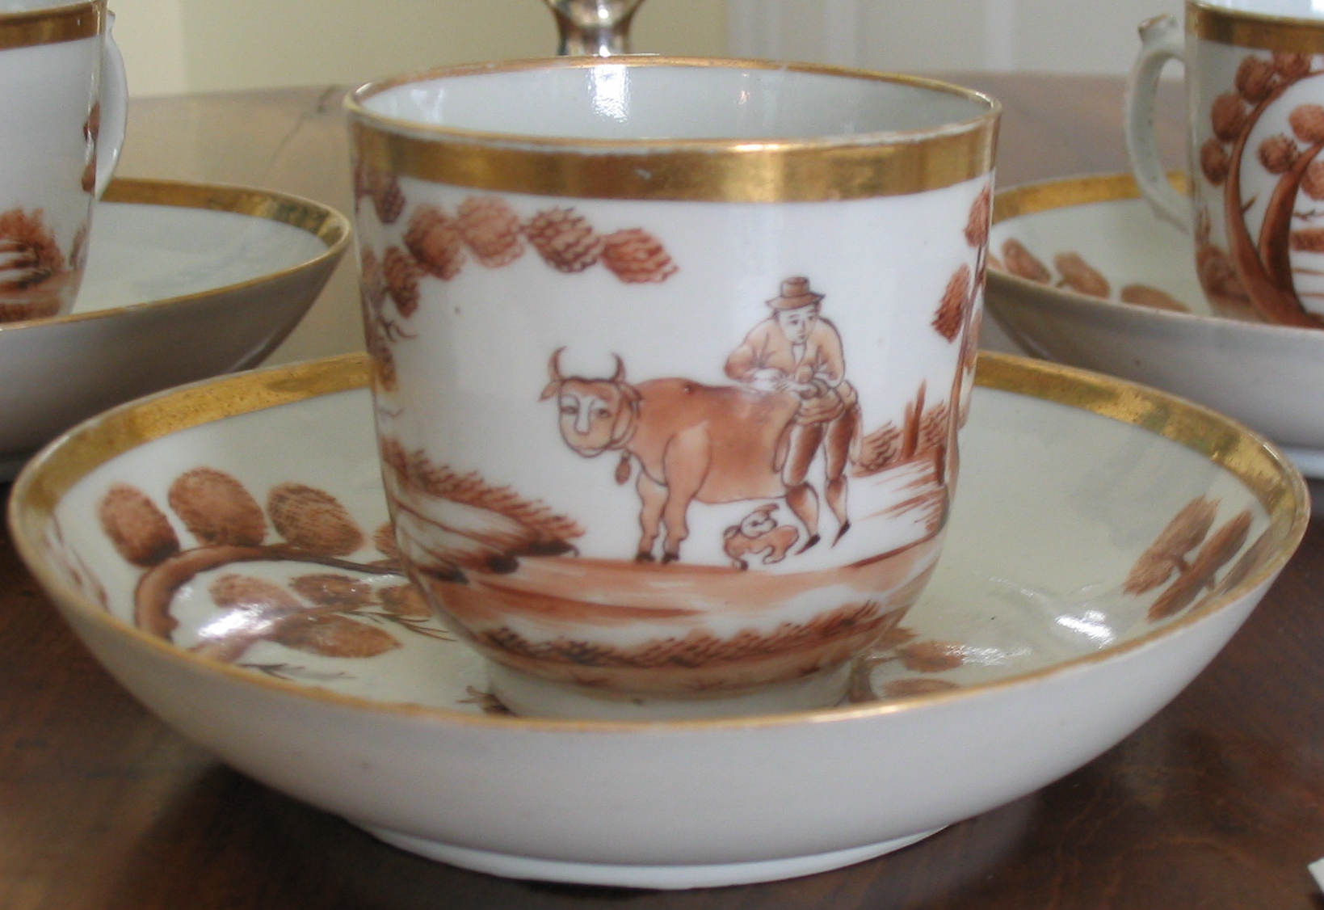
Notes:
“Quaker Farmer” Teacup (Chinese export porcelain, c. 1800)
QUOTE: “Thursday 2nd August 1804: I have by discretion had two eggs, fried bacon, cabbage Potatoes corn apple dumpling, and today boiled Rice, as good a dinner as I would ever wish to sit down to… I am [Dear] Ma, yourself Joseph Nourse”
What kinds of food is Joseph eating for dinner in this letter? Eggs, bacon, cabbage, potatoes, corn, apples, rice. Most of that would have been grown on his farm!
Asks:
o What do you see on the teacup? (A figure and animal)
o Did the Nourse family prepare or serve their own meals? (No, servants and enslaved people did)
o Why might the Nourse family have had two rooms with dining tables?
(the Dining Room was for entertaining, Breakfast Room was for small private meals)
o Why might the kitchen not be attached to the house? (fire prevention, heat, smell)
Now, direct your attention to the portrait of the man and woman hanging above the fireplace. This is Sarah and James, Joseph Nourse’s parents. Sarah is showing off the lace that she has made (remember, women made the clothes for the whole family) and James is showing off that he knows how to write (with a quill pen!) because not everyone had the money to be taught how to read and write 200 years ago. If you had only one image of yourself and you had to sit for many hours to have your portrait painted, what would you choose to show in your portrait? What is important to show about yourself?
Transition: Now that you have successfully spotted your I-SPY artifacts from early Washington and met some of the members of the Nourse Household, we are going to use our scientific minds to compare and contrast objects that the Nourses used in the Federal Period and objects that you use today!

Slide 24
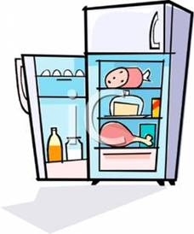
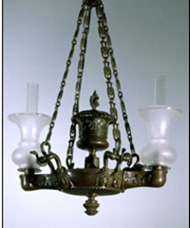
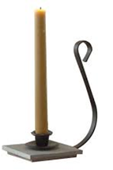
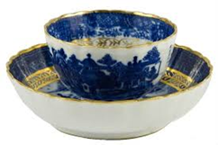
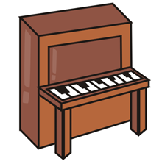
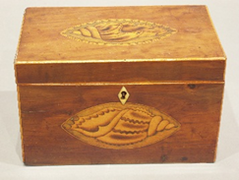
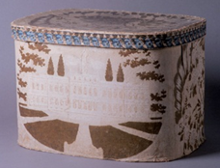
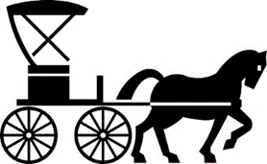
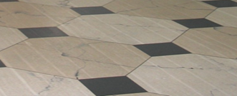
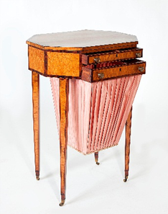
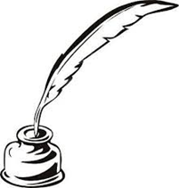
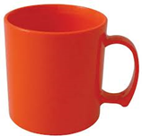
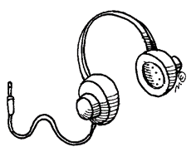
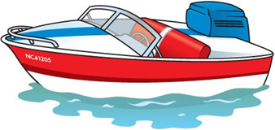
A B C D E F
G H I J K L
M N O P Q R
Notes:
What objects are from 1804 and what objects are from 2020?
A: 2020 (they didn’t have electricity 200 years ago!)
B: 2020 (thanks to these we can go to the grocery store and don’t have to grow our own food!)
C: 1804 (remember, we saw this in the lower passage! It used oil, not electricity)
D: 1804
E: 2020
F: 1804 (this is how they got light instead of light bulbs!)
G: 1804 (no cars in 1804!)
H: BOTH! People played the piano today and in 1804!
I: 1804 (remember, they kept tea in here!)
J: 1804 (remember, they kept clothes in here)
K: 2020 (hats looked different in 1804)
L: 1804 (remember, this is what they used to protect their floors in 1804)
M: 2020 (not as fancy as the cup shown as D)
N: 1804 (they used quill pens to write instead of pens and pencils!)
O: 2020 (they used sailboats in 1804 instead of motorboats)
P: 1804 (remember this is the sewing table we saw in the bedroom)
Q: 2020 (we can listen to music with headphones and electronics now instead of just in person!)
R: 2020 (this is what we use to protect our floors from dirty shoes!)

Slide 25
Now that you’ve learned how life was different and similar 200 years ago than it is today, keep your Detective eyes peeled for more clues in your home about how life is similar or different that it was in the past!

Slide 26
Look for these “I-Spy” objects throughout the house!
Geneva, New York
August 15 1813
My dear Mother,
Tell me when you go to… Northumberland—I should then be able to hear from you… in two or three days as it is on the express route…
Adieu to you & my [dear] father… [Charles Nourse]
“[The House sits] on a high, dry, & handsome situation, & consists of a large two story brick house with a passage through the center, four rooms on a floor, & good cellars”
(Description of Dumbarton House at auction)

Slide 27
Wednesday morning 13 Sep. 1796
My dear Love,
I mean to get a Forte Piano for Sepha when she has learned to play well on the Spinet…
Mia I am yours – J. Nourse
[Philadelphia] April 25th, 1803
My dear Josepha,
All my sisters go to Mrs. Jaudon’s school they review all the lessons they say through the week over on Friday & if they say them perfect… they obtain… books…
Jane Miller

Slide 28
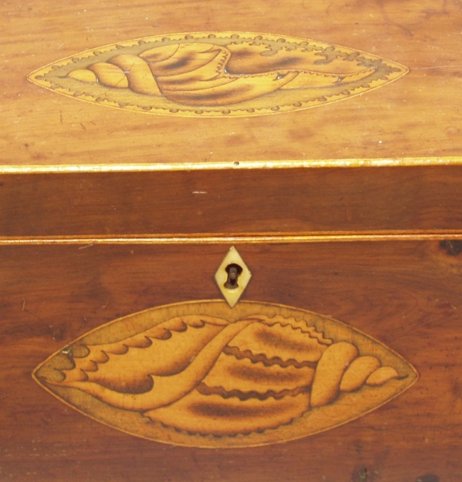
May of 1805
Mr. Foster called one evening, drank tea and emparted Mrs. Merry’s regards…
Joseph Nourse
Washington City, April 8th 1808
Dear Charles,
We have samples of excellent wool sent [to] us from different… States… not unworthy of the best manufactories in England.
Accept my wishes for your happiness… John Smith

Slide 29
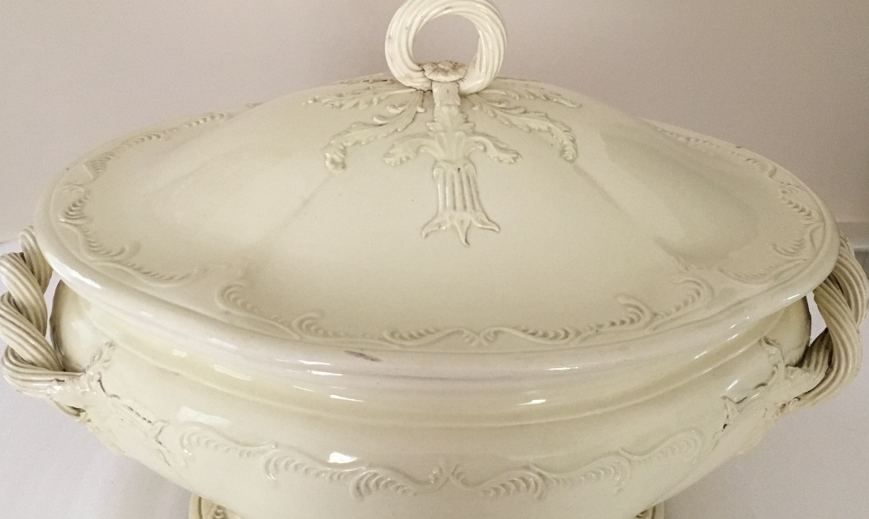
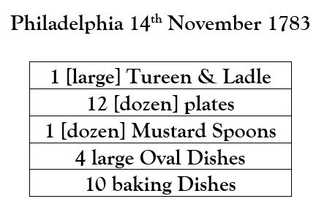
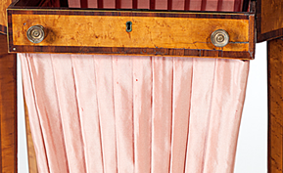
June 3rd 1805
My dear mother,
I purchased ten yards of… linen… which Jane has amused herself with making a covering for [Dinah]… and making Fran an apron.
From your ever affectionate [Charles Nourse]

Slide 30
Monday Morn July 15th 1796
My Dear Friend,
…Take my Spring Muslin habit and peticoat with the cuffs… You will please to roll them as small as possible and pin a strong pocket handkerchief round them…
Farewell my dearest Friend says your own, Maria
Thursday 2nd August 1804
I have by discretion had two eggs, fried bacon, cabbage Potatoes corn apple dumpling, and today boiled Rice, as good a dinner as I would ever wish to sit down to…
I am [Dear] Ma, yourself Joseph Nourse

Slide 31
Thursday 2nd August 1804
Richard came down yesterday with a bag of apples which Dinah is pairing for dinner…
[Sunday] evening 5 August 1804
Dinah has supplied the table with fried bacon, an apple dumpling and a rice pudding…
Distribute my love to all, [Joseph Nourse]

