Slide 1
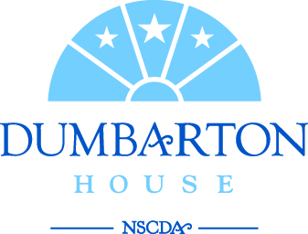
Parthenon to Portico Explore the intersection between American and ancient Greek architecture and political ideas!
Notes:
This program introduces students to some of the ways that the political ideals and artistic culture of Classical Greece influenced the American government and early American architecture and art

Slide 2
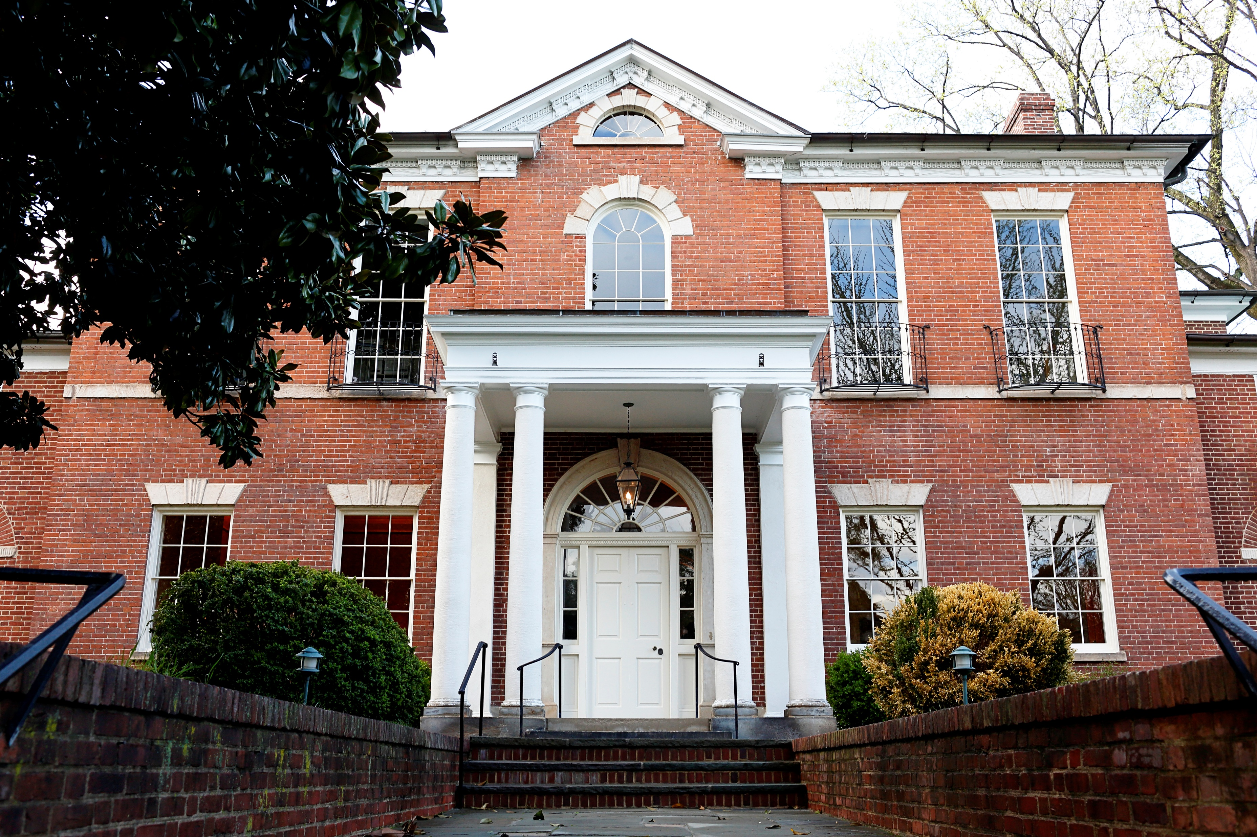
Dumbarton House
Notes:
This program uses the collection of Dumbarton House, a Federal period historic house museum located in Georgetown, Washington DC.
Dumbarton House was built in 1799 and finished in 1804. The first long-term resident of Dumbarton House was a man by the name of Joseph Nourse, who was the First Register of the US Treasury. He worked for our first six presidents. He resided in this house between 1804 and 1813 with his wife Maria and about 10 servants, black and white, indentured and enslaved. He also had two children who survived to adulthood, Charles and Anna Maria (or Josepha), though they did not live in this house full-time. Although many other people lived here over the past 200 years, we focus on the period when Joseph Nourse and his household lived and worked here.

Slide 3
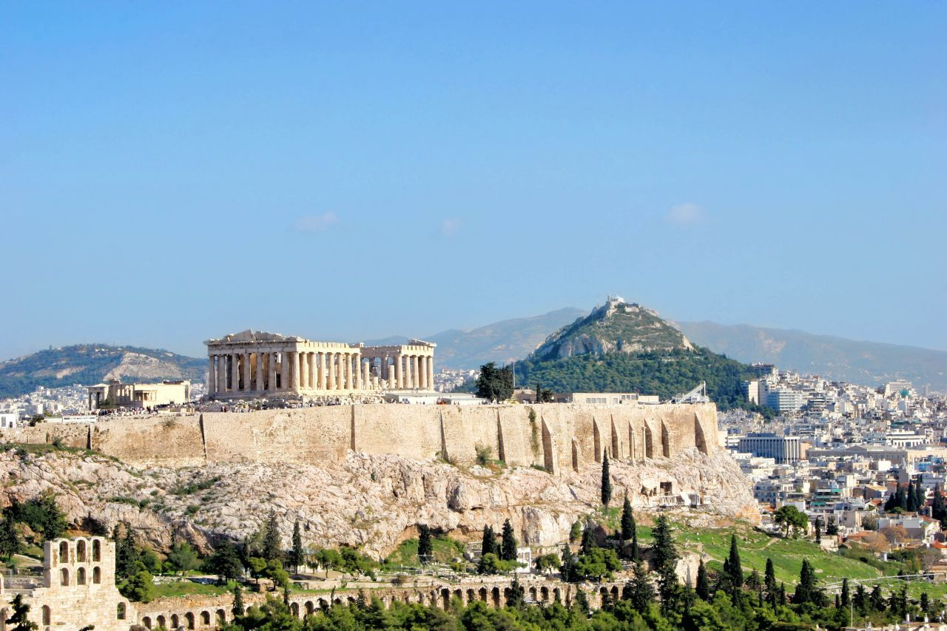
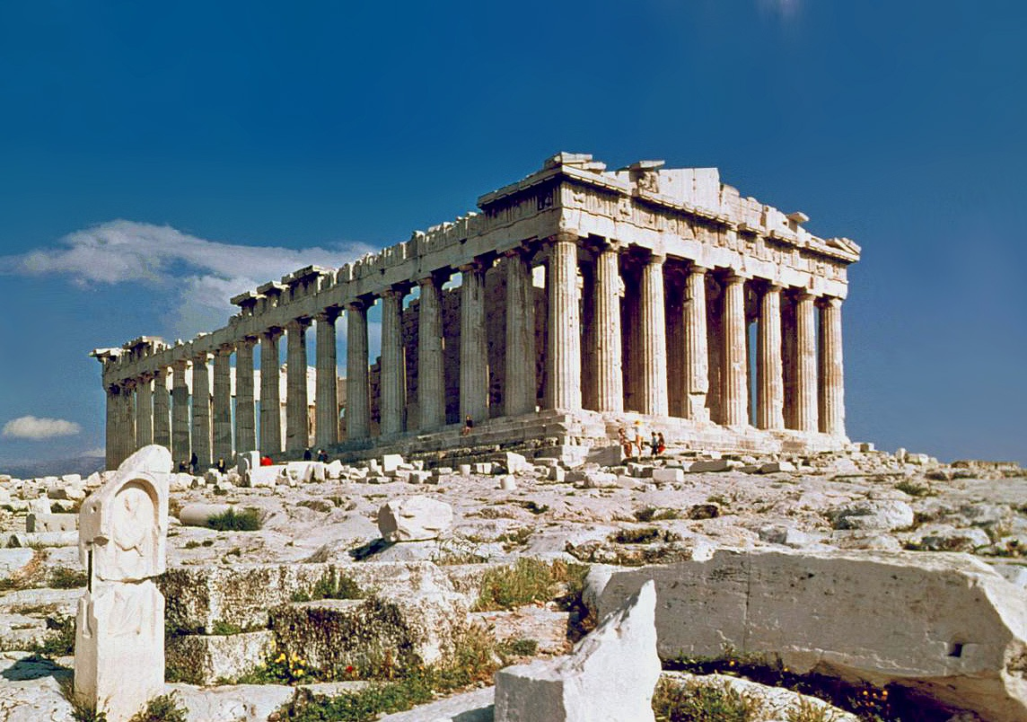
Notes:
Early Americans were heavily influenced by Ancient Greece and we can see that in their art, architecture, and government. Let’s start by looking at how their architecture was connected.
This is an Acropolis which means “high city” in Greek. Most city-states in ancient Greece had at their center a rocky mound or hill where they built their important temples and where the people could retreat to if under attack. The most famous acropolis is the one in Athens. The Athenian Acropolis is home to one of the most famous buildings in the world: the Parthenon. This temple was built for the goddess Athena and used as a gathering place for Greeks to practice religious ceremonies, as well as, discuss politics and civic issues.
Can you think of an example of a building(s) in DC that sits on a hill, houses our government and has some similarities to this architectural style?

Slide 4
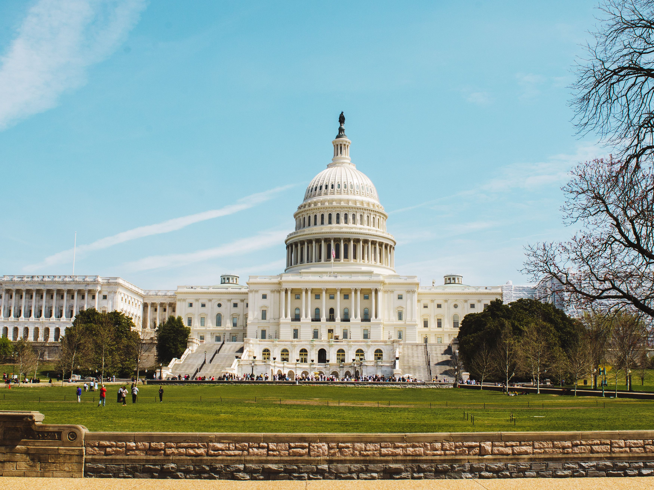
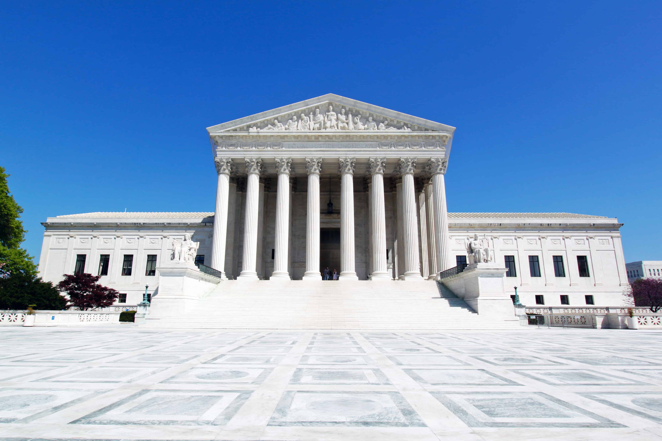
Notes:
The Capitol and the Supreme Court are both on Capitol Hill and Legislative and Judicial Branches of our government.
The Legislative and Judicial branched make up 2 of our 3 branches of government. What is the third branch of our government or what building is it represented by?
The Executive Branch / President / White House
In Ancient Greece, the different city states had different forms of government
Monarchy - rule by an individual who had inherited his role.
Oligarchy - rule by a select group of individuals.
Tyranny - rule by an individual who had seized power by unconstitutional means
And in Athens, which served as the inspiration for our American government they had a Democracy - rule by the people. In the United States, we have a Representative Democracy – a government whose citizens vote for representatives. These representatives create and change the laws that govern the people.
Now that we have a better idea of the government and architecture, we are going to tour museum and see actual examples of how this was incorporated into the day-to-day lives of early Americans.

Slide 5
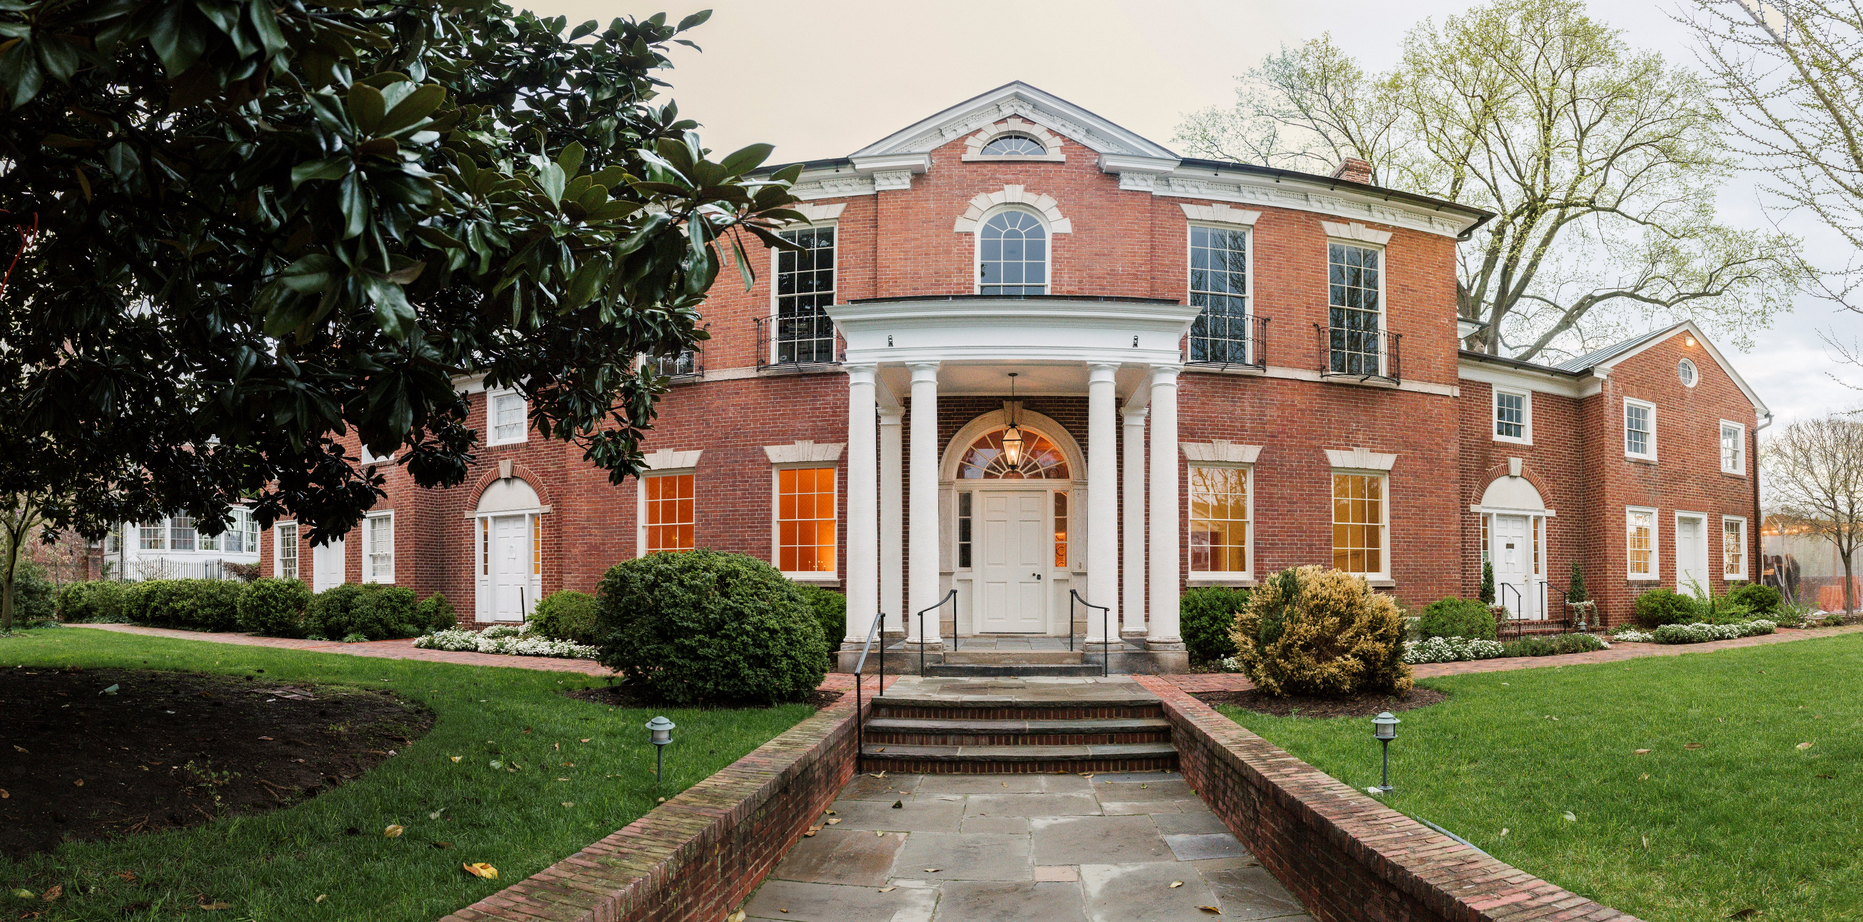
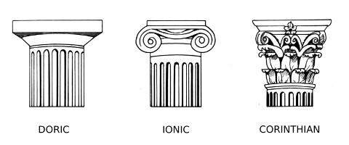
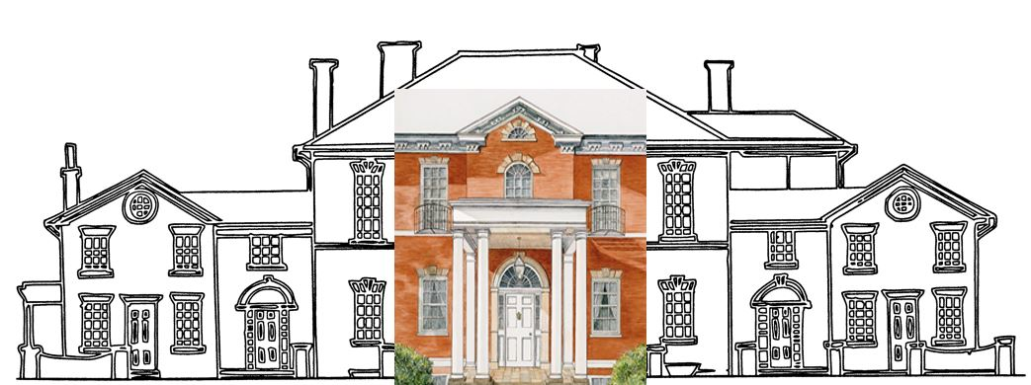
Notes:
Let’s take some time to learn more about the exterior (our outside) architecture of Dumbarton House.
Dumbarton House was built in the Federal Period by a man named Samuel Jackson, right around the time that the Federal Government/the capital of the US moved from Philadelphia to Washington, D.C. We were a new country looking back at some ancient civilizations to serve as models for our art, architecture, and government. Samuel Jackson, the architect, included some of the elements of classical Greek architecture into the design of Dumbarton House, which we see.
What other buildings does Dumbarton House remind you of? Maybe the White House?
Let’s look back at the Parthenon which we saw earlier – What are some similarities between Dumbarton House and the Parthenon?
Symmetry
Columns: Explain there are 3 types of columns,
Doric (flat), Ionic (scrolls), Corinthian (acanthus leaves).
Which type does Dumbarton House have? (Doric)
Arched Window: arches are stronger than flat roofs, so they provide better support for buildings and bridges.
Why do you think the Parthenon is made of marble and Dumbarton House is made of brick?
Marble was a raw material available in Greece.
Brick kilns were prevalent in early Georgetown. Brick was also considered a luxury building material in the Federal Period – it was a way to show off one’s wealth, as most upper-class houses were constructed of brick, stone, or plastered.
Are there design elements of Dumbarton House that are similar to characteristics of other buildings you are familiar with (home, school, local museum)?
At the end of this program, you are going to have a chance to create your own building.

Slide 6
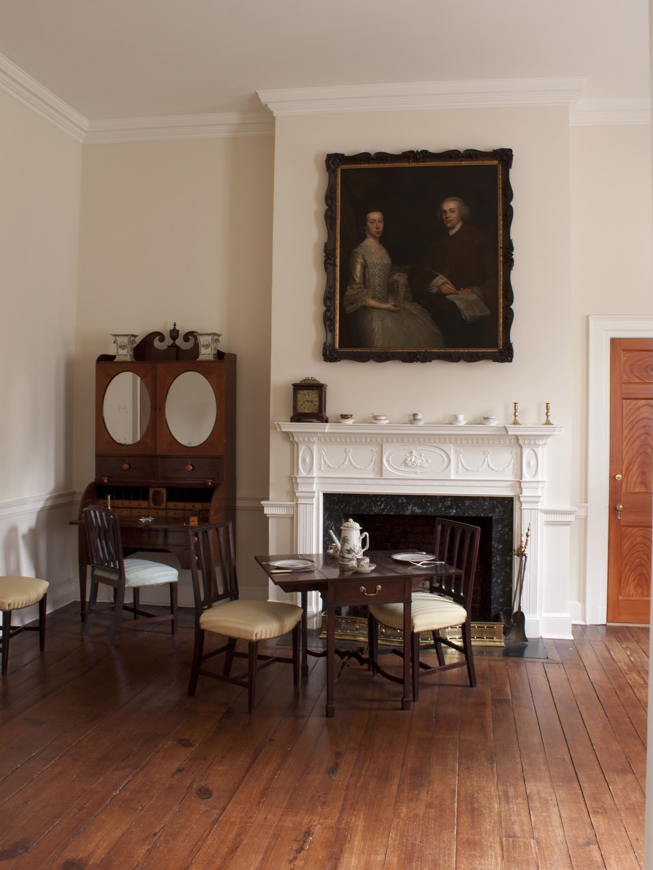
Notes:
This is the breakfast room. It was used by the Nourse family for private meals with no guests, writing, and reading. It might be similar to your living room or family room today. Take a minute to look around the room – do you see anything that reminds you of ancient Greece?

Slide 7
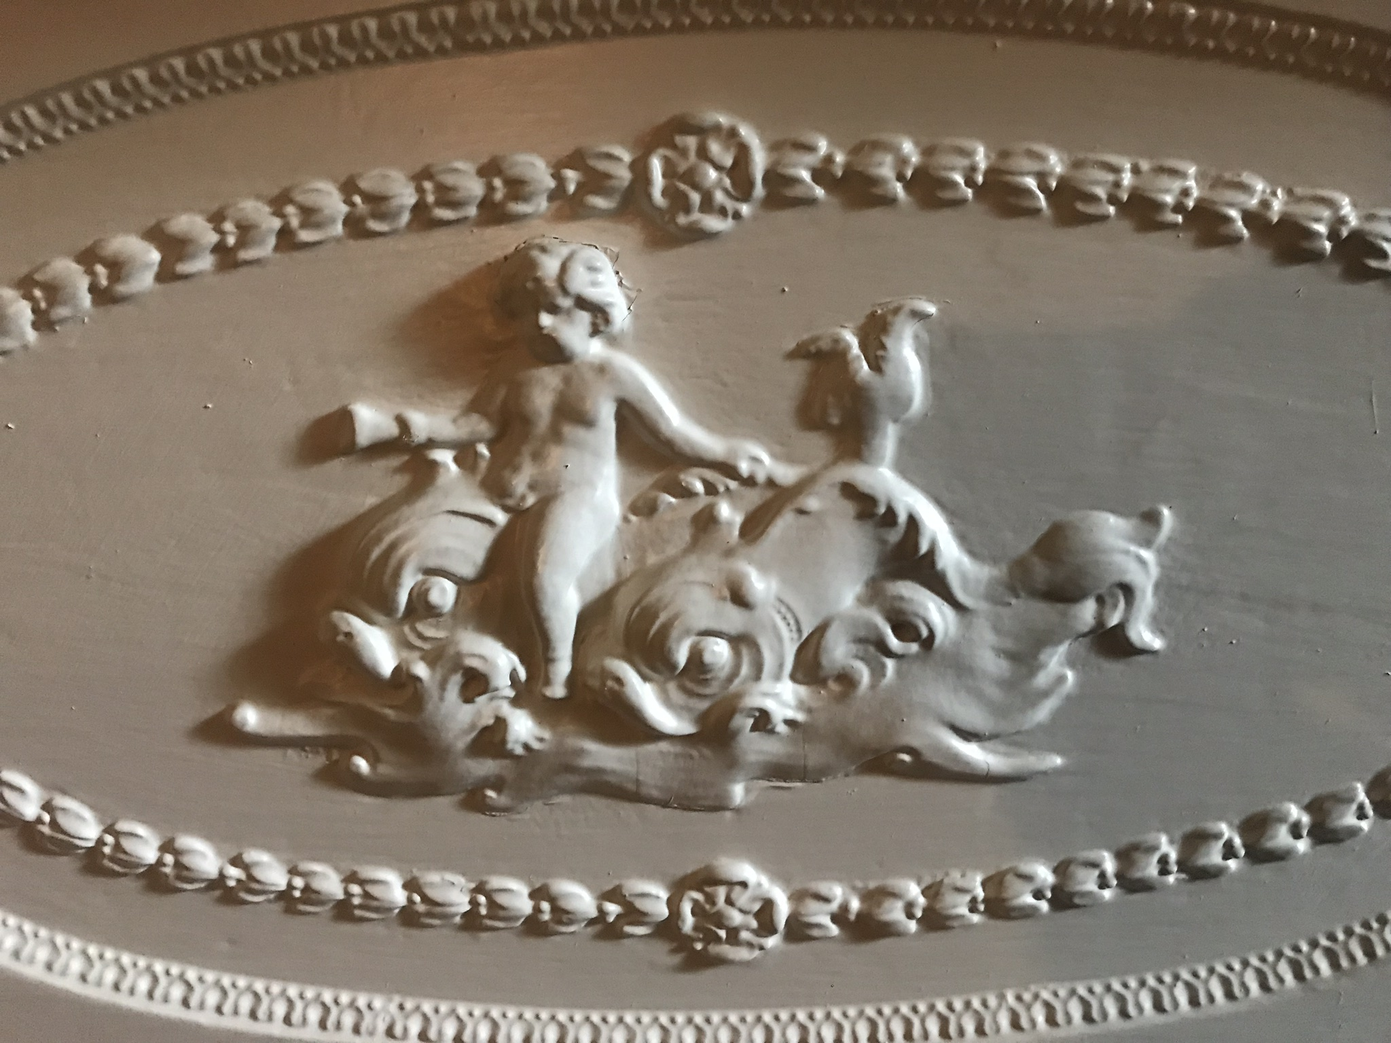
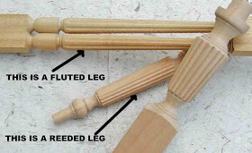
Notes:
The central plinth on the Baltimore writing desk:
This urn is decorated with laurel leaves from an evergreen tree. It looks like a trophy. In ancient Greece, wreaths were given to victors, both in athletic competitions, including the ancient Olympics, and in poetic competitions. You can see these laurel wreaths better on the fireplace – see the loops that look like “W”s?
Fireplace mantel:
This did not have to be here – it was put here for decoration, to make it fancy. The Ancient Greeks told stories about their gods. These stories are called myths. The Greeks believed their gods and goddesses and other magical beings really existed. They believed these magical beings could interfere in their lives, to help them or to hurt them.
What do you see in this carving? (Dolphins, water, baby). These features are associated with Poseidon, the god of the sea in Greek mythology.
Here we see a column! It’s not supporting anything and is just for decoration. This is a great example of reeding in architectural decoration! Reeding is made up for convex ridges (meaning it comes out) and fluting is made up of concave grooves (meaning it goes in. There is an example in the lower passage!).

Slide 8
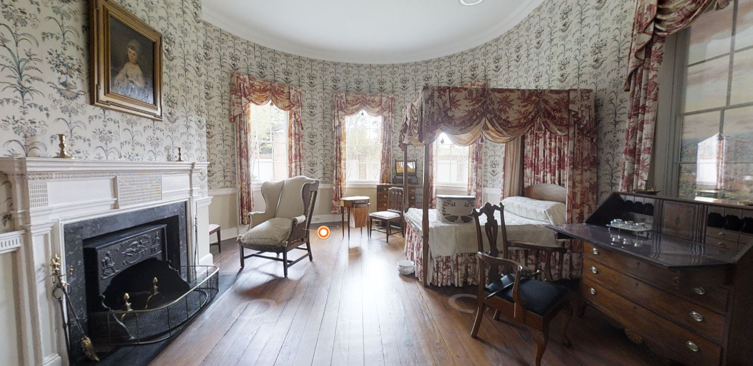
Notes:
This was Joseph and Maria’s bedroom, and where Maria would write letters and sew clothing and linens for the household.

Slide 9
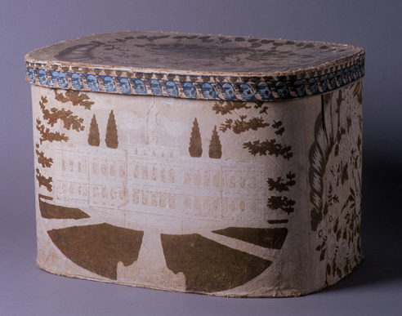
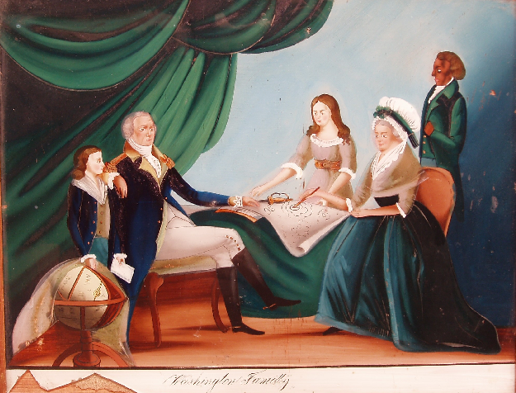
Notes:
Band Box:
What symbol of America do you see on this? Eagle! In Greek mythology, Zeus (the king of the gods) was represented by an eagle. This is a great example of how early Americans showed their pride in their new country. The building that looks like the White House is the New York State House, from when New York was the capital of the US.
Washington Family Portrait (hidden behind the bed hanging):
Who is in this picture? Why is George Washington important to American history? George Washington was the first President of the United States, but he was the General of the Continental Army before that. After the colonists defeated the British in the Revolutionary War, they needed to set up their own government. The founding fathers, including George Washington used ancient Greece as a model for the new American government.

Slide 10
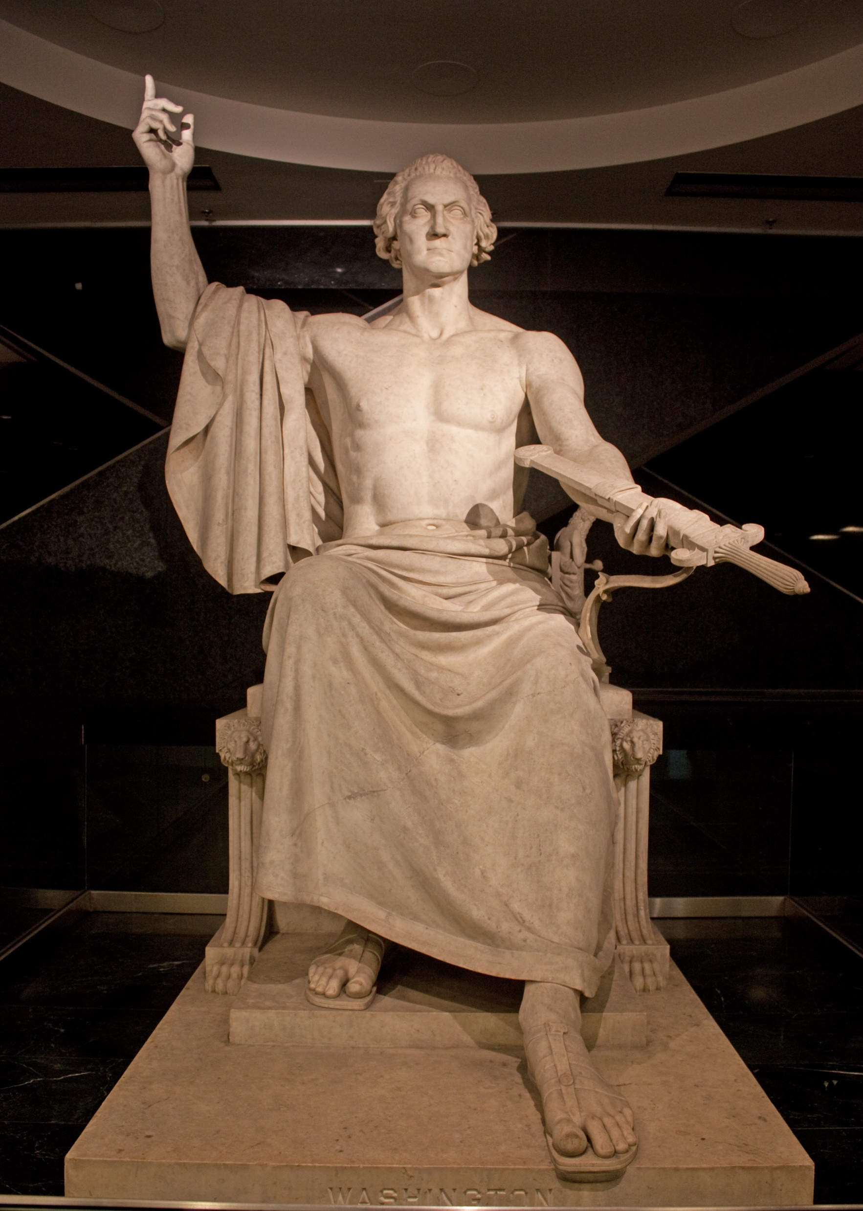
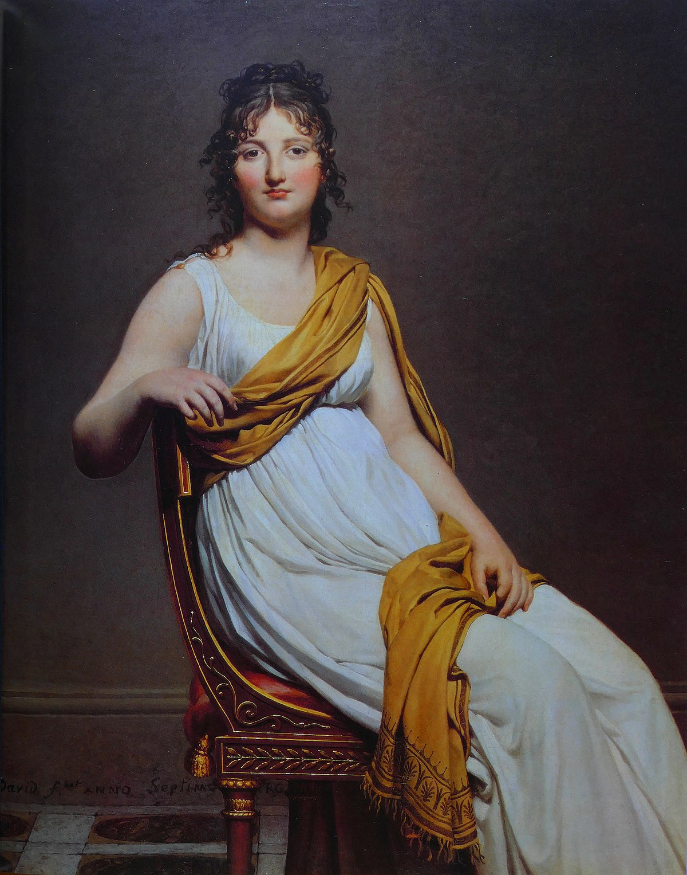
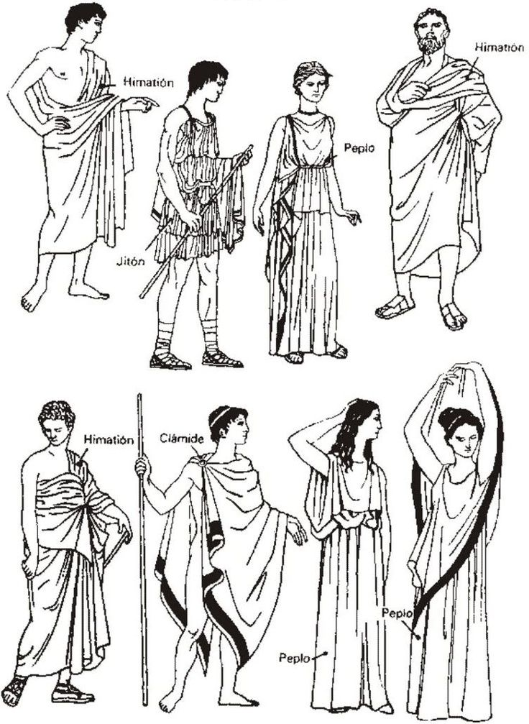
Statue of George Washington
Portrait of Madame Raymond de Verninac
Ancient Greek clothing
Notes:
In addition to artwork, the Federal Period clothing was inspired by ancient Greece. Does anyone know the word that is most commonly associated with Greek clothing? You’re maybe thinking of a toga, which was inspired by the ancient Greeks, but is actually Roman. In Greece men would wear what was called a himation and women would wear a peplo.
Can you see the similarities between the outfit of the woman in the middle and the women’s outfits on the right?
We often see images of the Founding Fathers portrayed in clothes inspired by ancient Greece, like this statue of George Washington, which was made to go in the Capital Building, but which you can now see in the Smithsonian Museum of American History. Who does he look like here? Zeus. Is it strange seeing George Washington like this?

Slide 11
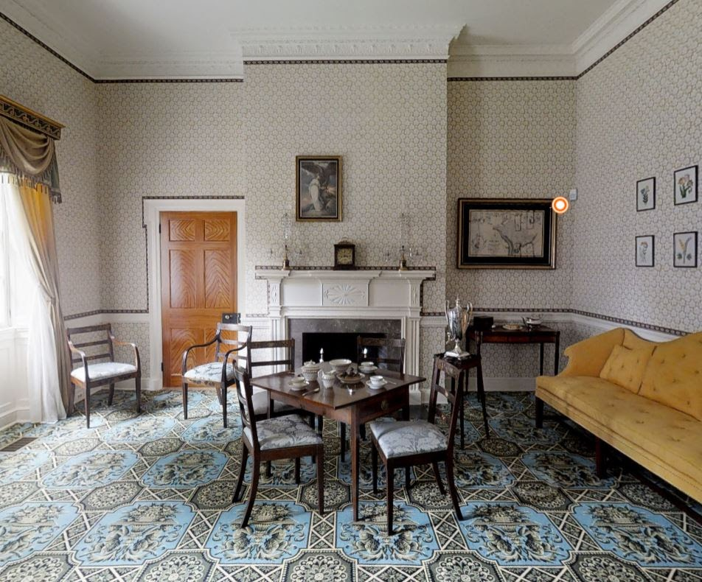
Notes:
The Parlor is on the public side of the house and was used to entertain guests. See how it’s more fancy than the Breakfast Room, with the colorful carpet and wallpaper?

Slide 12
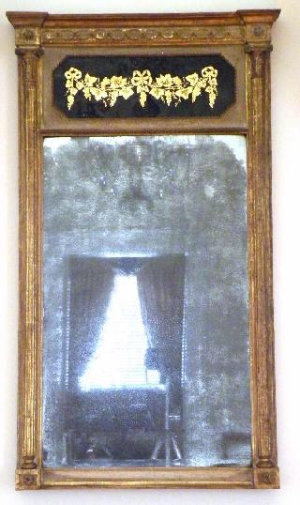
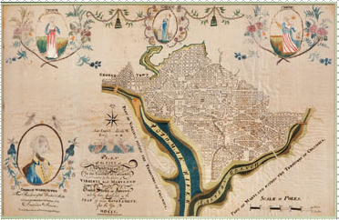
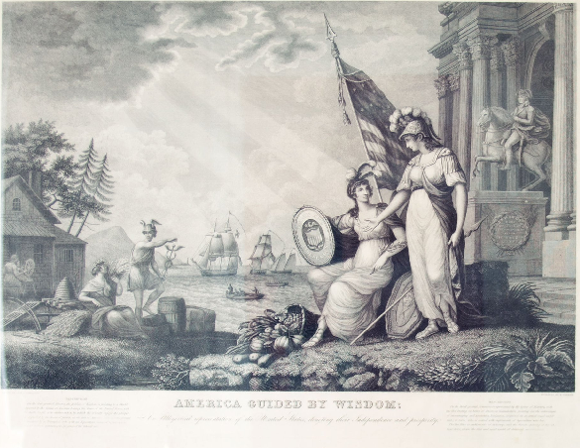
Notes:
Looking glass (hidden out of frame):
Remember, there are three different types of columns. Who can tell me what type of columns are on the looking glass? (Ionic)
Lemoine Sampler:
What do you see in the picture? This was sewn by a 12-year old girl who showed off what she had learned.
-D.C. was created to be the capital of the United States. Is D.C. a city or a state? Unlike Greece, all 50 states are joined under 1 Federal Government with Washington, D.C. as the capital, which is neither a city nor a state. It’s a district!
-Greece had many different city-states, which had their own citizens, as well as their own forms of government, laws and money. However, the Greek city-states had similarities among them. They shared the same language, culture, and religion. Have you heard of Athens or Sparta? They are examples of two city-states in ancient Greece.
- Some city-states were ruled by a king (like the city-state of Corinth), while others were ruled by a small group of people (Sparta) and one city-state (Athens) experimented with democracy, or rule by many. Every citizen in Athens could vote on laws and changes in the laws.
America Guided by Wisdom Engraving (hidden on the wall behind the viewer):
-In the foreground stands the Greek Goddess of Wisdom and Warfare, Athena. Can anyone see her symbols? (she wears a helmet and carries a shield and spear). She’s pointing to a shield bearing the arms of the United States and the inscription “Union and Independence.” See the American flag behind them? That’s another clue about who the seated woman is.
-The seated woman is a representation or symbol of “America”
-On the ground, Athena’s shield has the image of the head of Medusa. In Greek mythology the gaze of Medusa could turn humans to stone. In Greece this image was used to ward off enemies and could be found in temples and on dress, dishes, weapons, and coins throughout the Greece.
-What symbols can you think of that represent America today? (A Cornucopia, like the one on the ground, but also eagles, George Washington, the flag, corn, tobacco leaves)

Slide 13
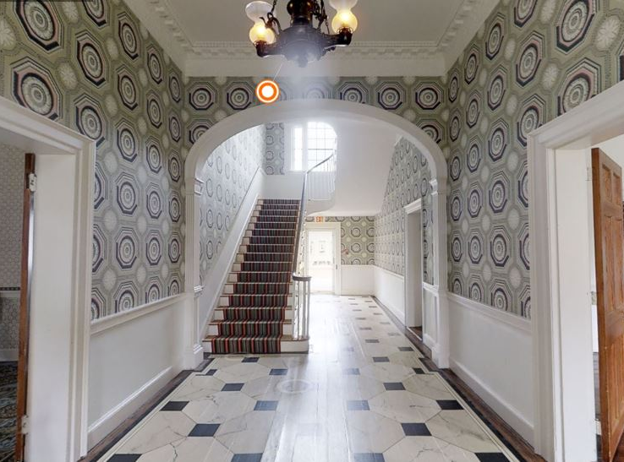
Notes:
This was the main entrance of the house when it was built. Because this would be the first room guests would see in the house, let’s take a minute to look around the room to see what architectural features you can see in this room. Would you be impressed walking into this room for the first time?

Slide 14
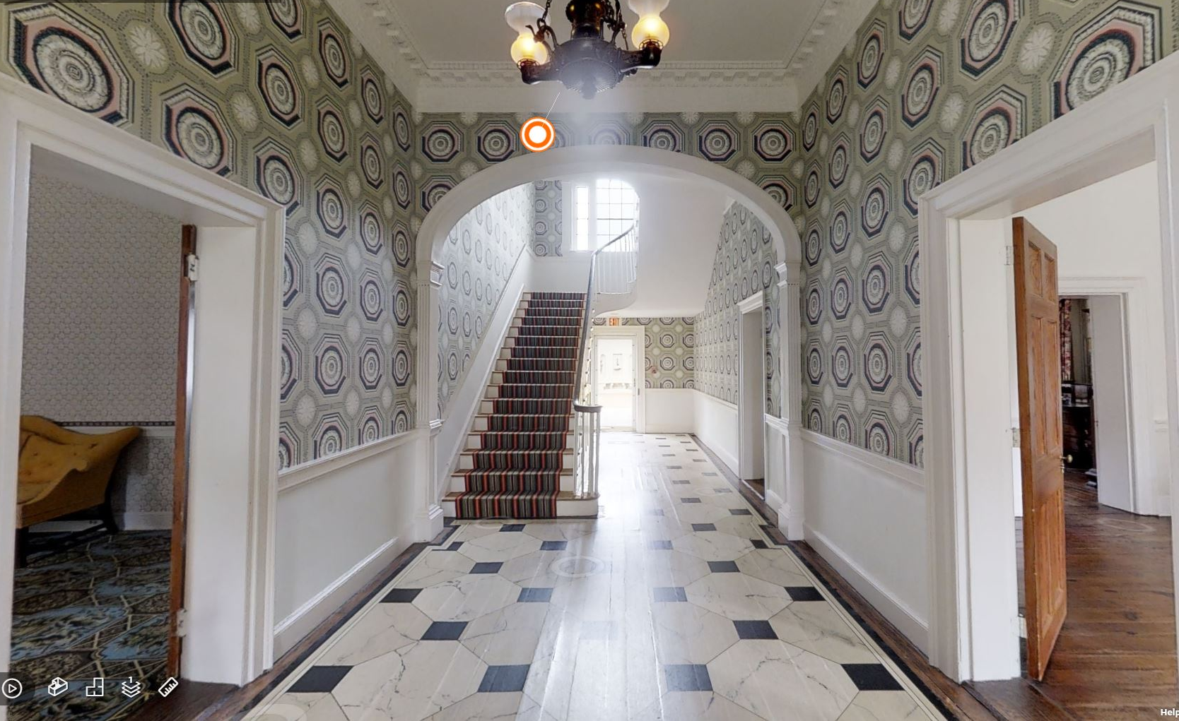
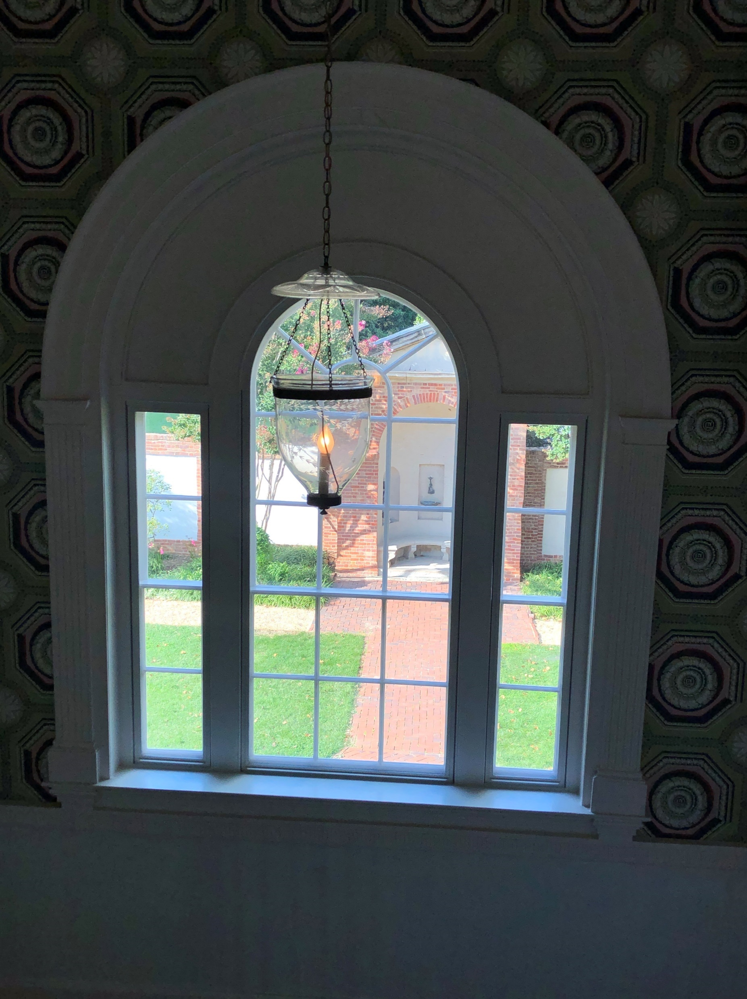
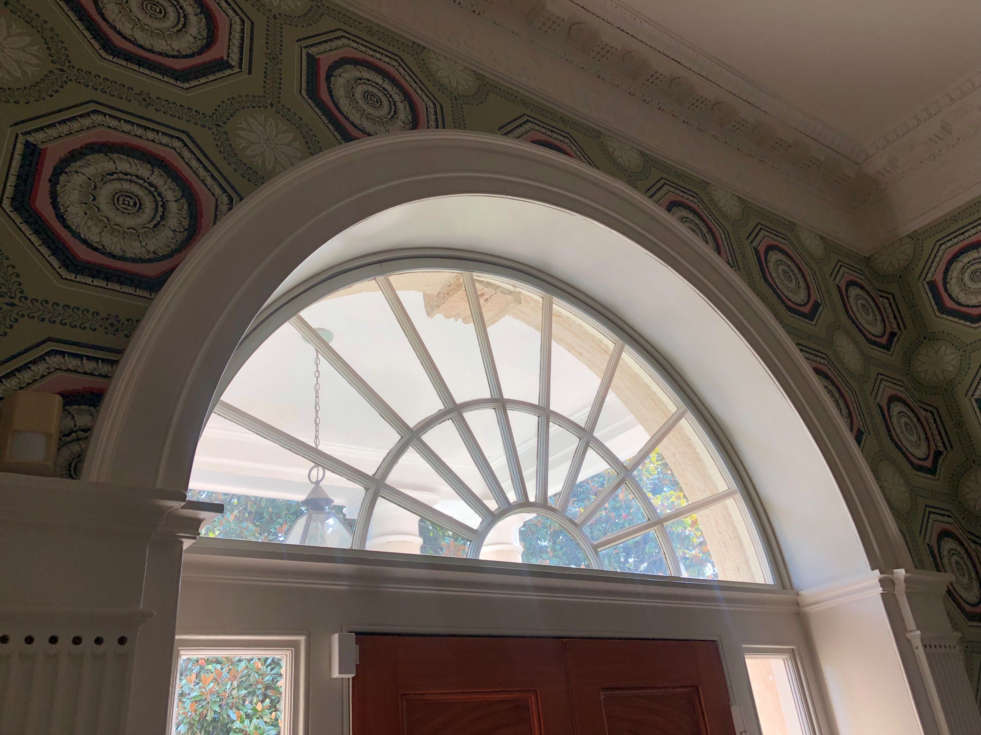
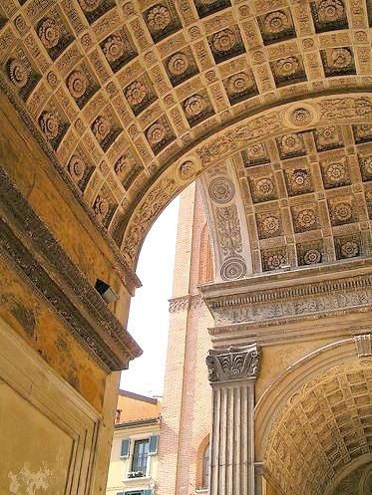
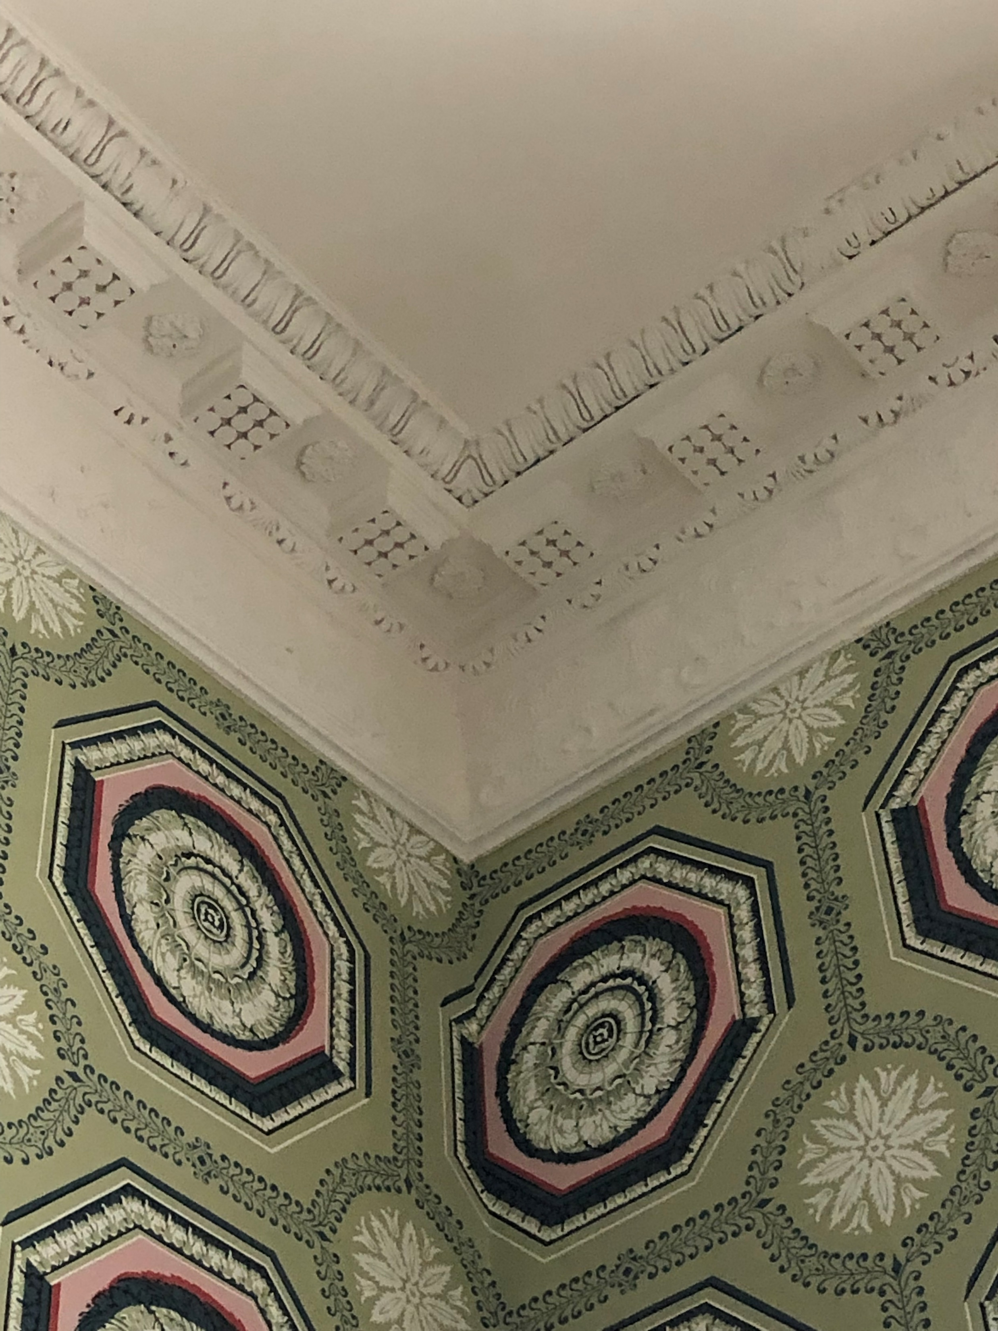
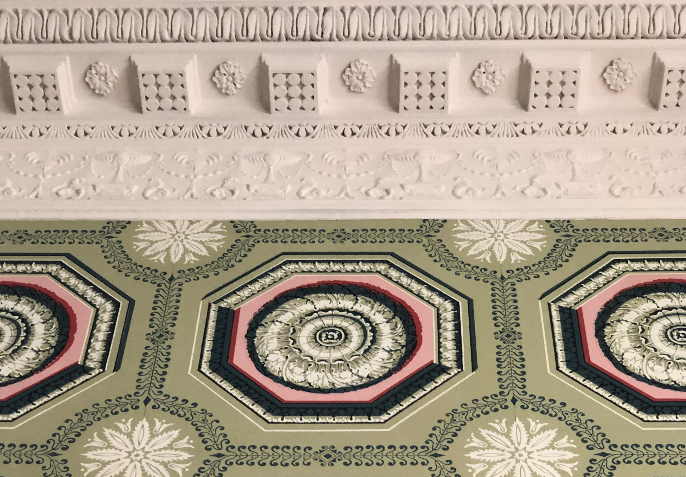
Notes:
This space creates a symmetrical house, meaning it is the same on the left and right. Two rooms on either side of the central passage, downstairs and upstairs. It also exemplifies division of public and private space, calls attention to importance of public life
Palladian Window (on the landing of the stairs) is a large window with an arched center and narrow rectangular sections on both sides. This window lets in light which was very important before there was electricity.
Arches were invented by the Greeks and provide better support for buildings, bridges, etc. Arches were stronger than flat roofs. We see any archway here in the middle of the house.
Activity for three people: two people, stand across from each other and hold up your arms straight in front of you with your hands touching. The third person should push on their arms to show that a flat roof will fall if too much weight is applied. Now have the two people make an arch with their arms and the third person push on their arms to show that an arch is much stronger.
The fan light above the door is another use of the arch.
Wallpaper can be seen throughout the house and in this room this big, repeating pattern makes the room look even taller than it really is. This kind of pattern is made of “coffers” which often decorated the ceilings of Greek buildings in plaster.

Slide 15
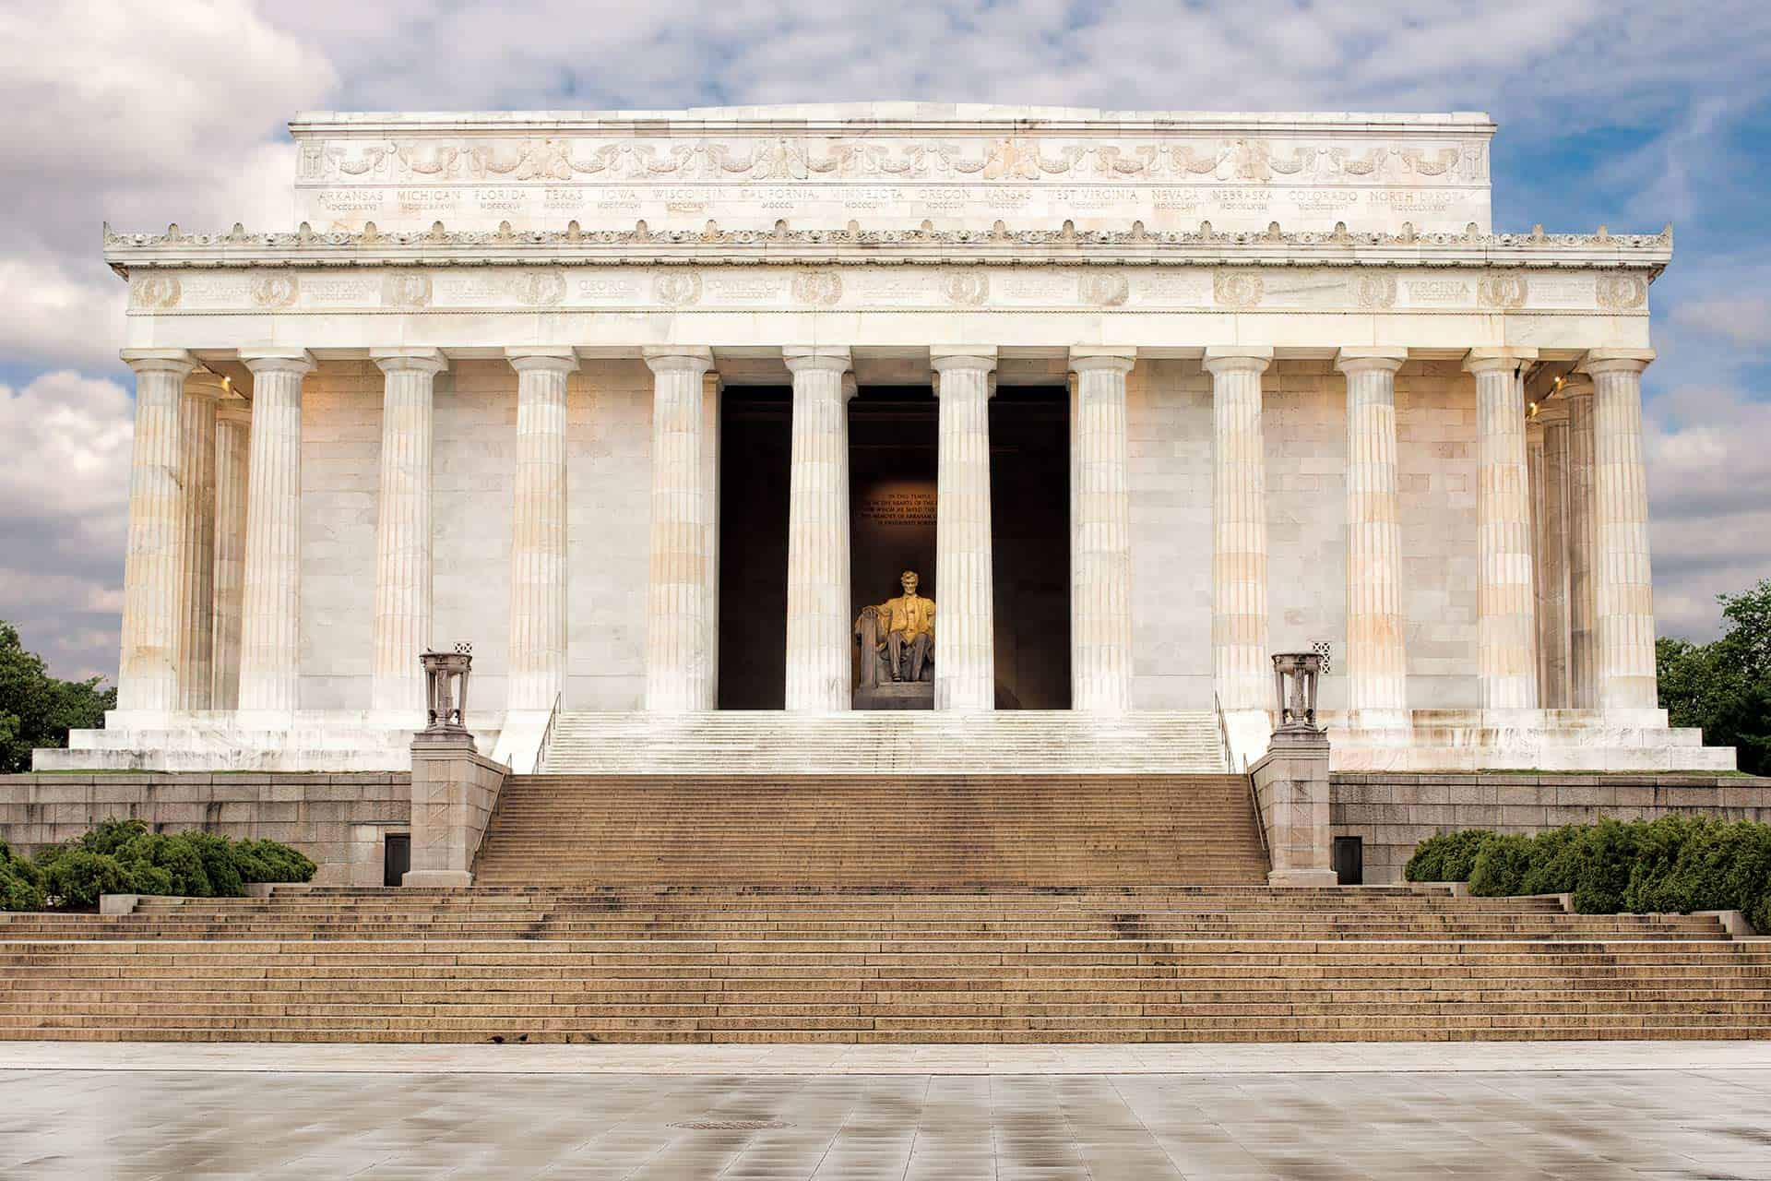
Notes:
So we’ve looked at how Dumbarton House has used different characteristics of Greek architecture and design. Remember that Dumbarton House was built around 1800.
Have you seen the Lincoln Memorial? It was finished in 1922, more than 100 years after Dumbarton House. Even though they were built in different times, they both show how Greek ideas continue to influence the United States. What do they have in common? (columns, decorative frieze). As you can probably see throughout your town or city, the government continues to use Classical Greek designs in their buildings, which works as a clue to tell people that building has a government function.

Slide 16
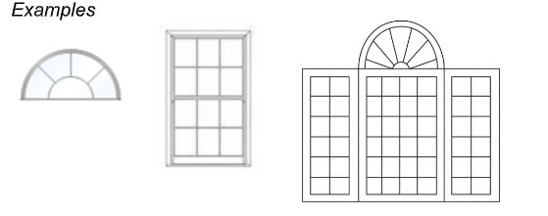
Designing My Building
5. Now draw your building
1. My building will be used for:
2. How many floors will my building have?:
3. Will my building have columns? How many?:
4. The windows in my building will look like (draw):
Notes:
Now you get a chance to design a building using some of the architectural or stylistic elements that we learned about from ancient Greece or the Federal period.
Using this worksheet, first identify how you want your building to look. Think about a public space that you feel your community needs (for example, a memorial, a library, a town hall, etc.) and what qualities you think it should have. When passersby see your building, how do you what them to “read” it? What types of activities do you want to take place in your building? Think about how you can build a model of this. How can you depict columns? How can you depict steps?
Using craft supplies like construction paper, recyclables like cardboard boxes and toilet paper rolls, popsicle sticks, foam sheets, cardboard, glue, markers, toothpicks, pipe cleaners, and tape, build a model of your building!
After constructing your building, discuss your design. What is the building used for? What classical elements/ideas did you incorporate? What designs elements did you include that may not be classical? What do you want people to feel when they see or use your building? Why did you decide to design this building?

Slide 17
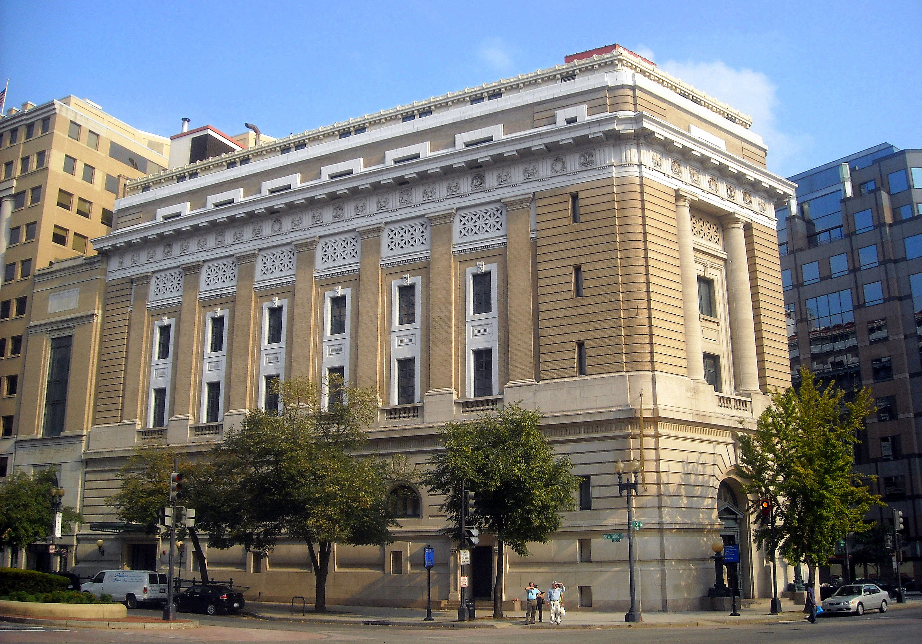
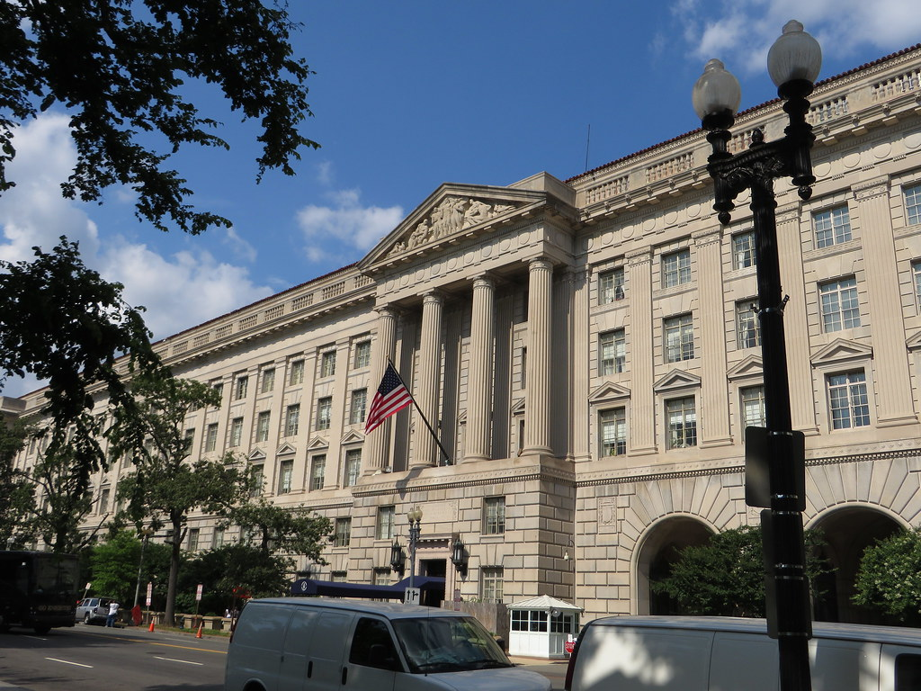
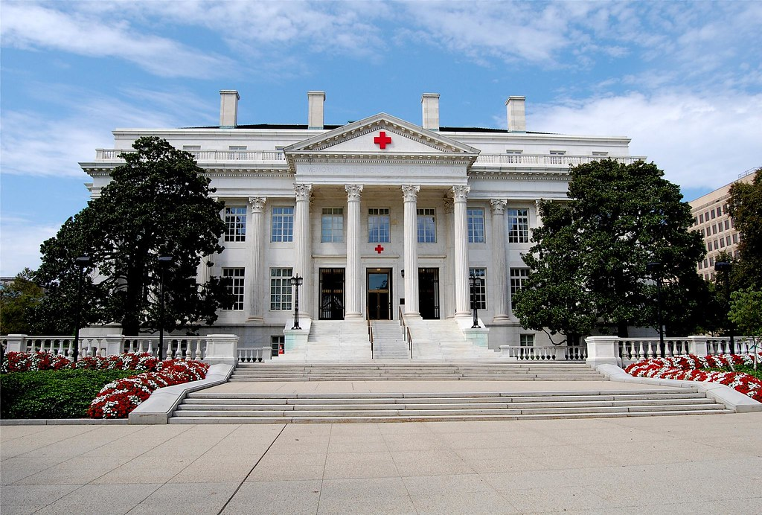
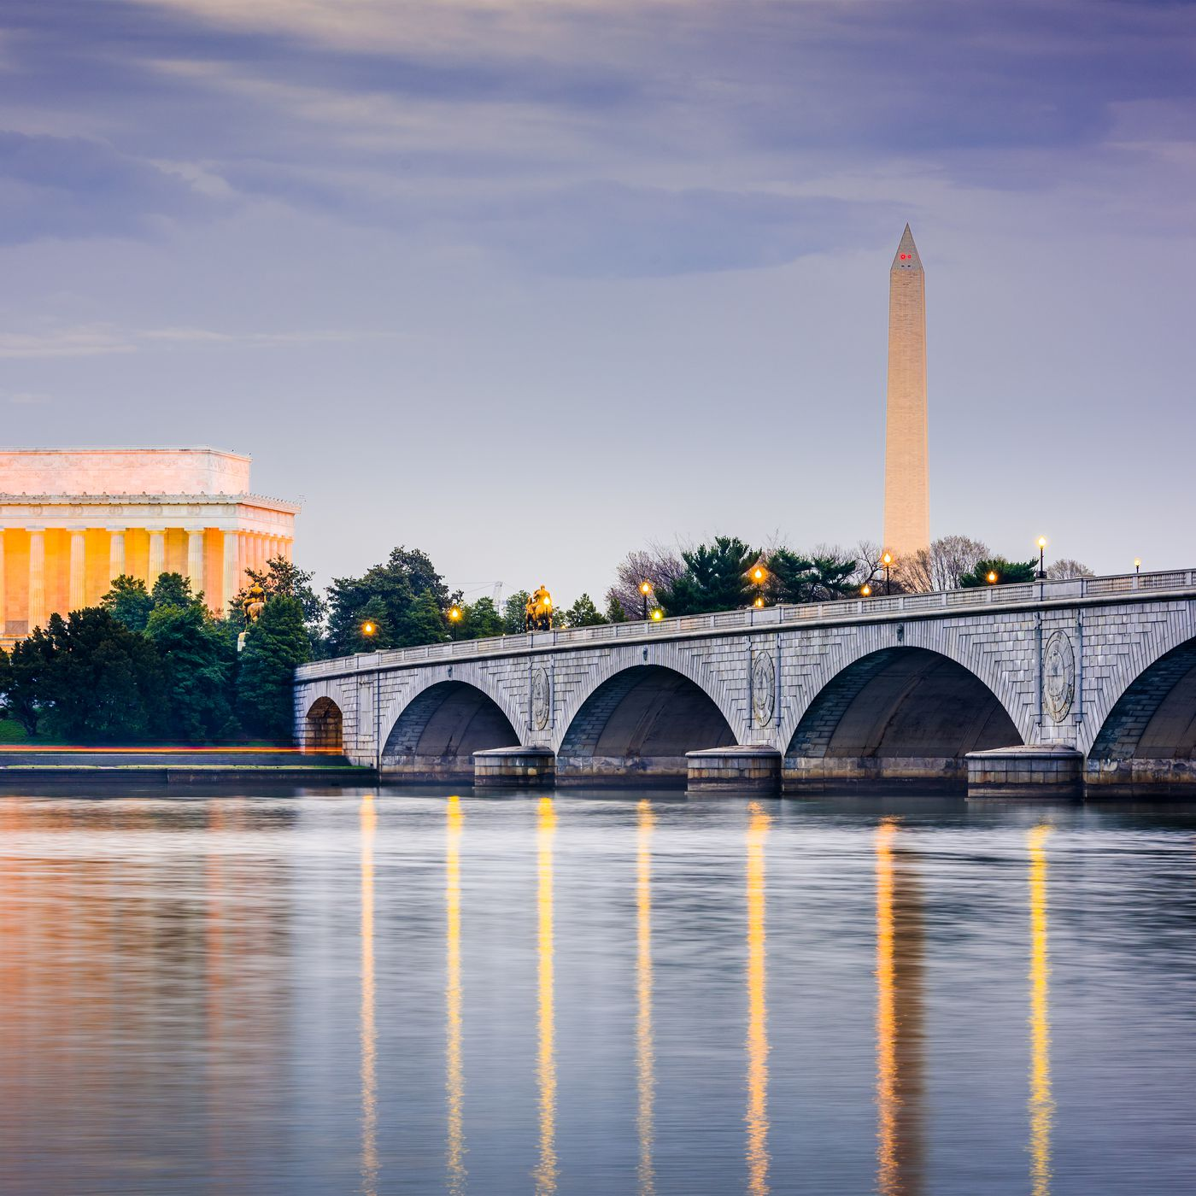
Herbert Hoover Building in Federal Triangle
National Museum of Women in the Arts
American Red Cross Headquarters
Arlington Memorial Bridge
Notes:
Today we have learned about the influence of Greek thought and ideas on both American government and architecture by looking at the architecture of the Parthenon and Dumbarton House. Now maybe you can start looking around in your neighborhood and community to see if you can find other examples of classical architecture!

